Slide 1

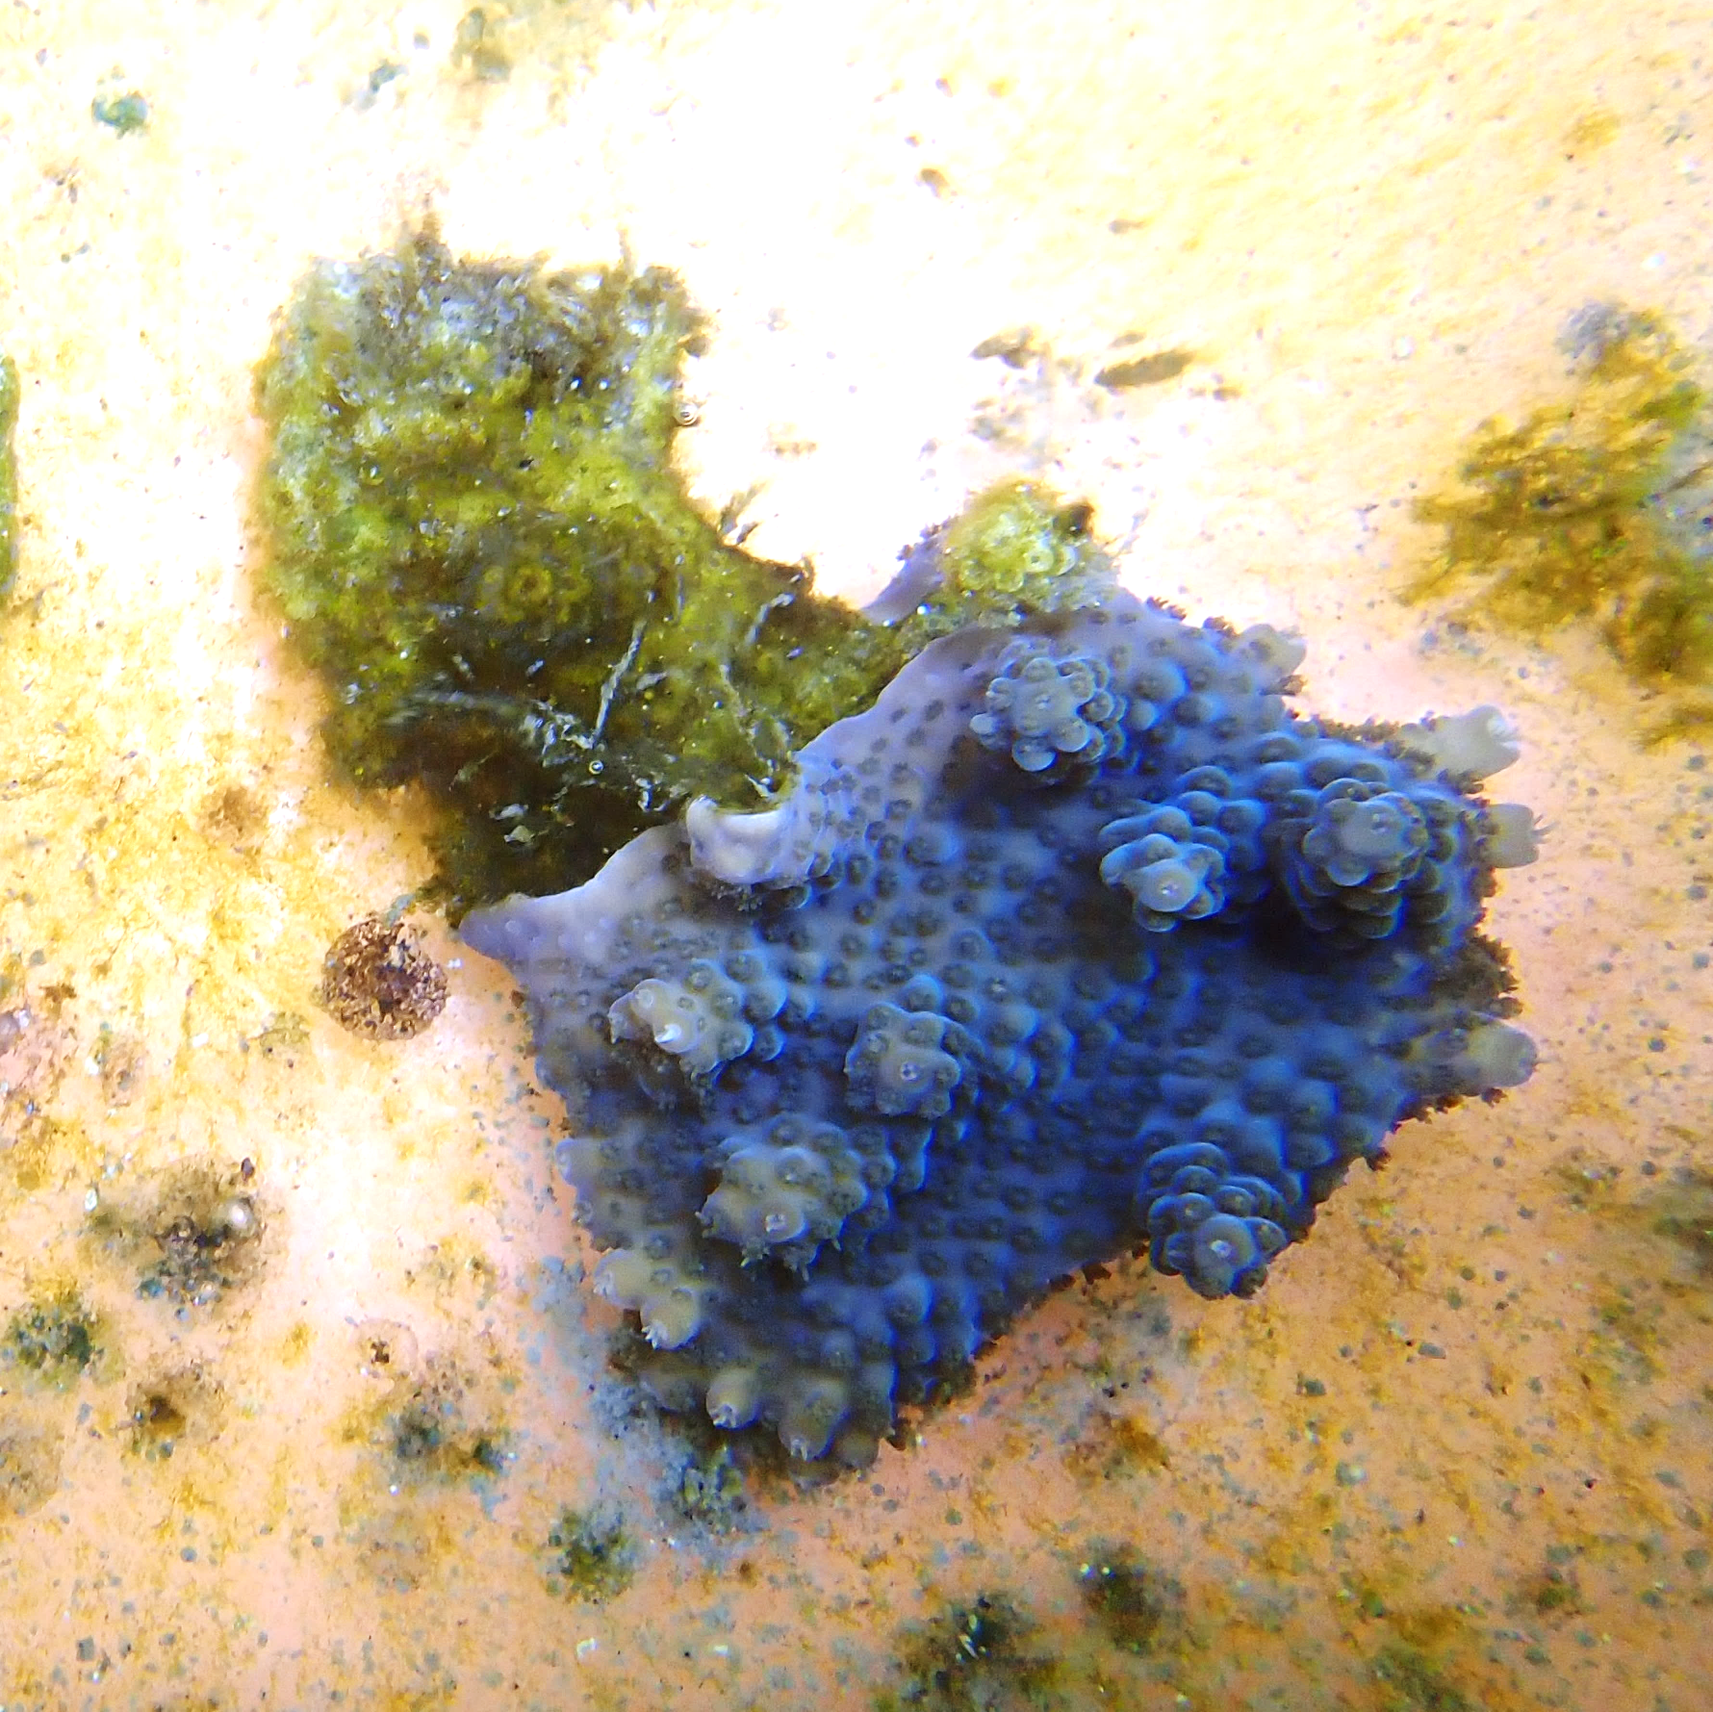



pH (mV)
O₂ (umol/L)
Dummy
Ocean Acidification
n = 3 (3 control & 3 acidified) randomly selected

Slide 2
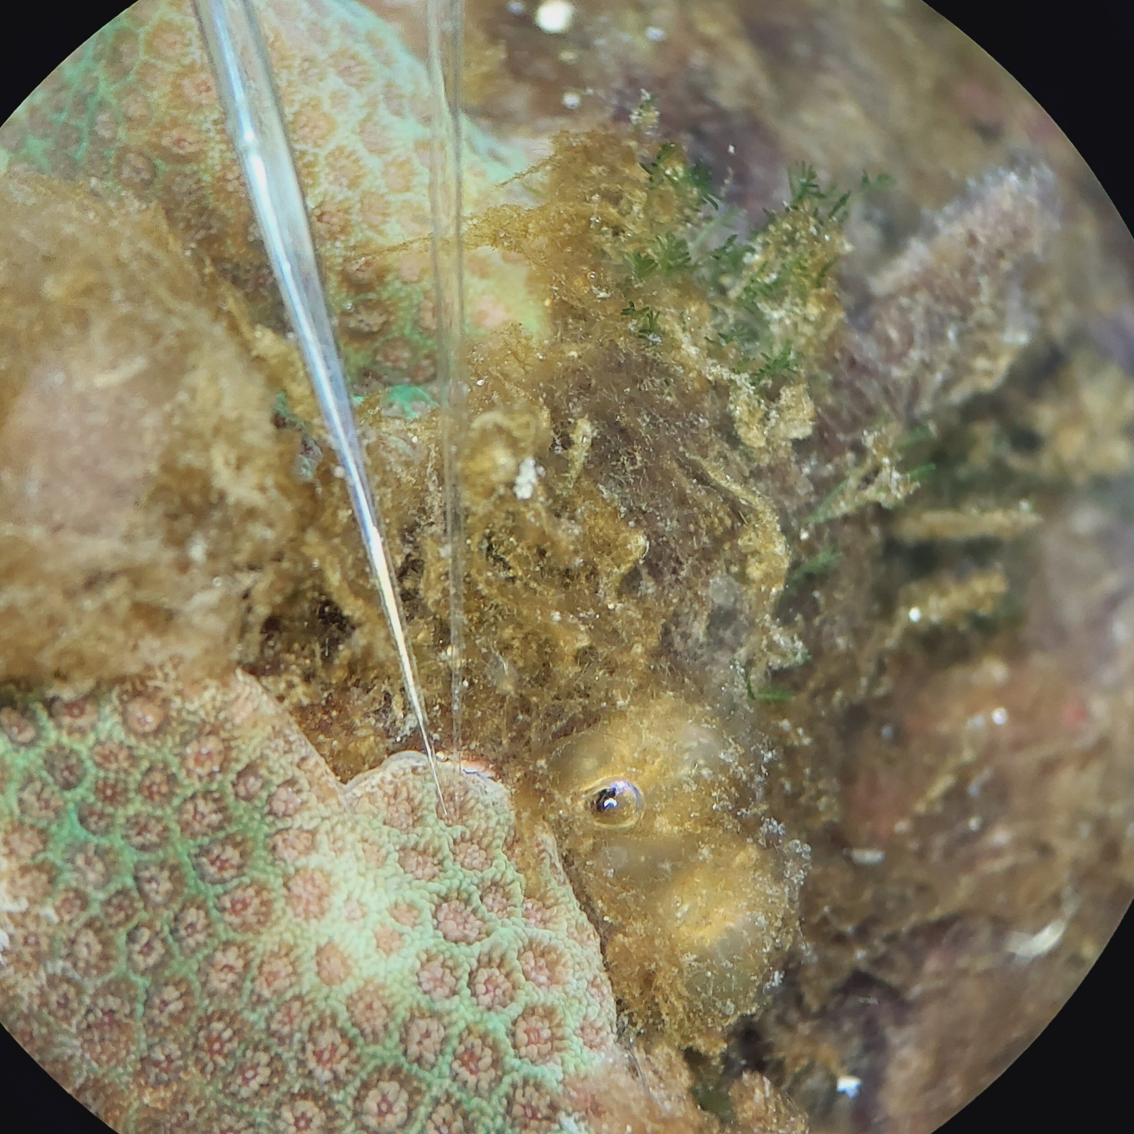
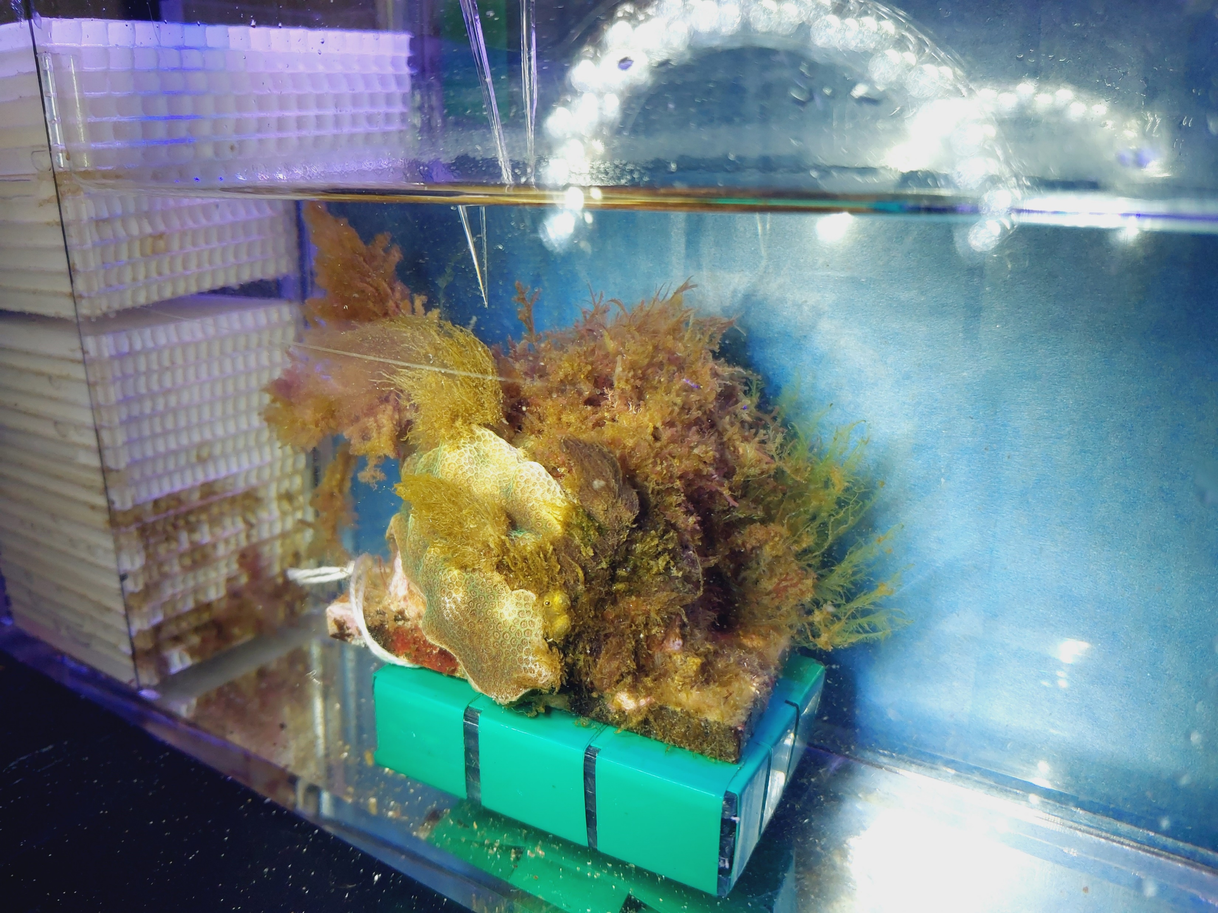
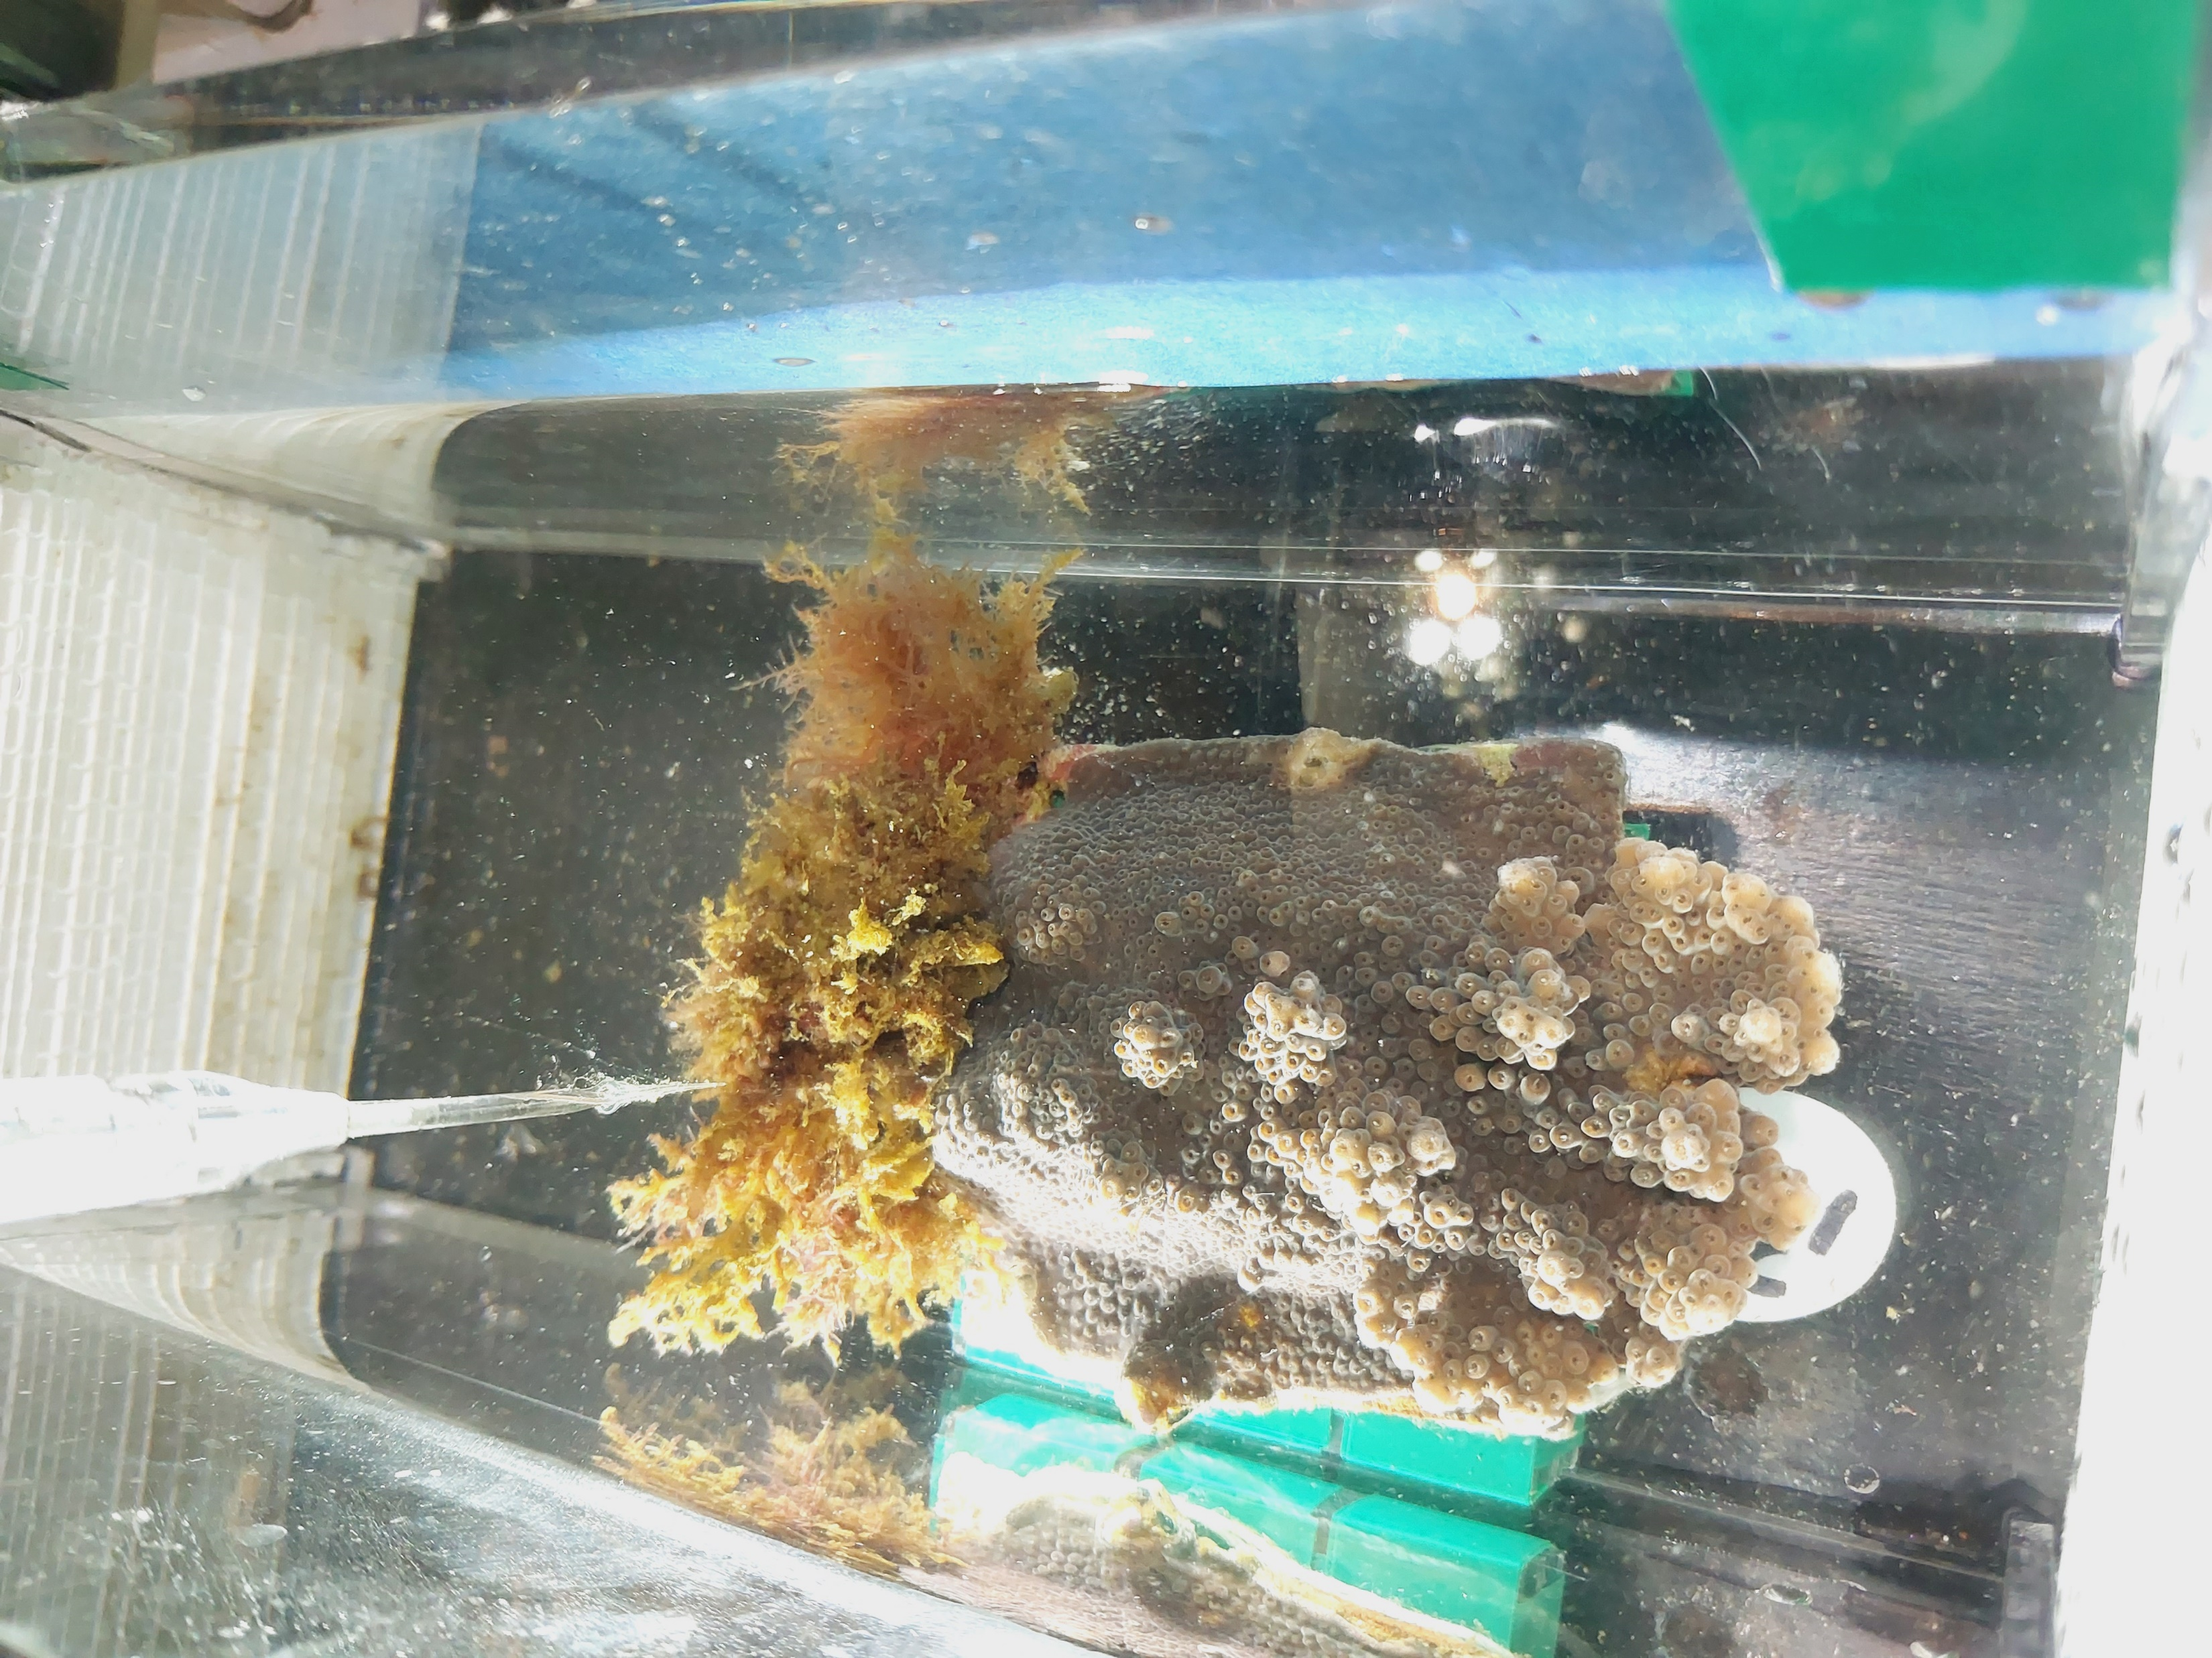
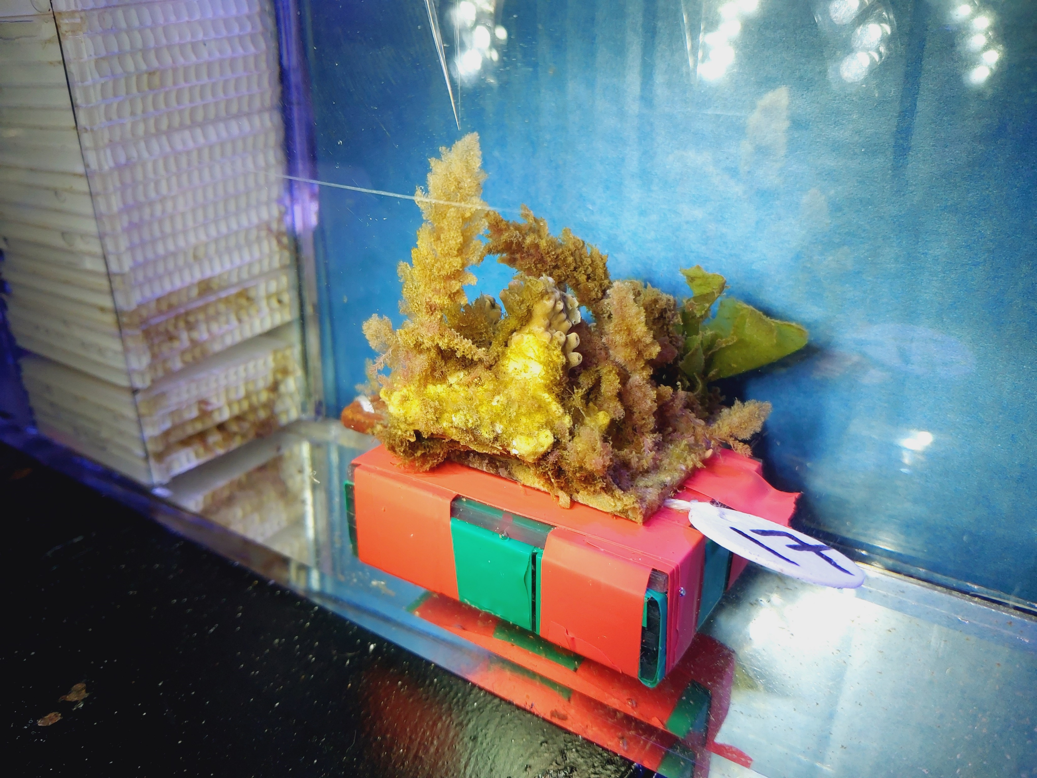
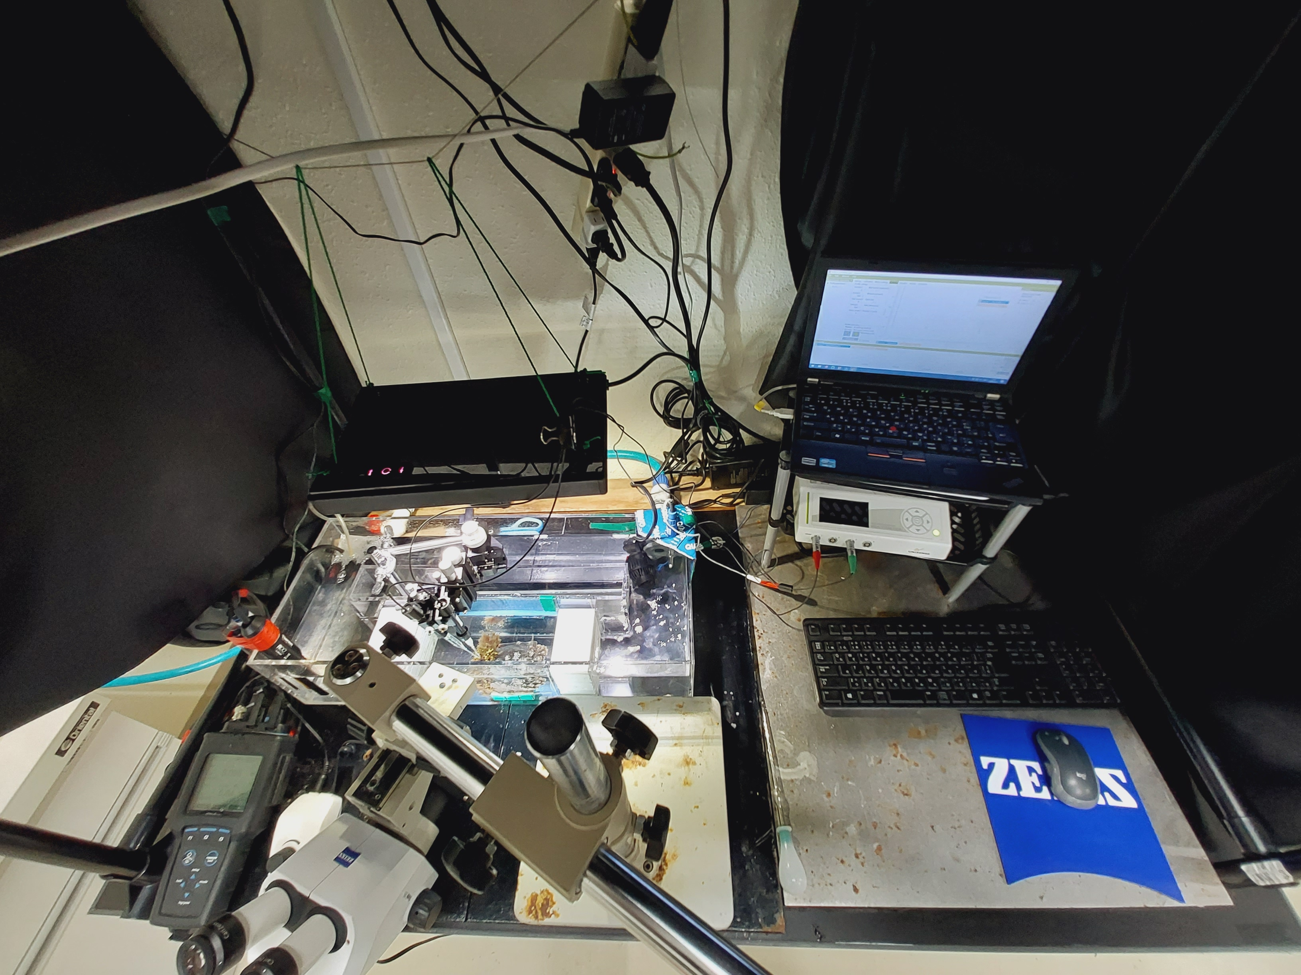

Slide 3
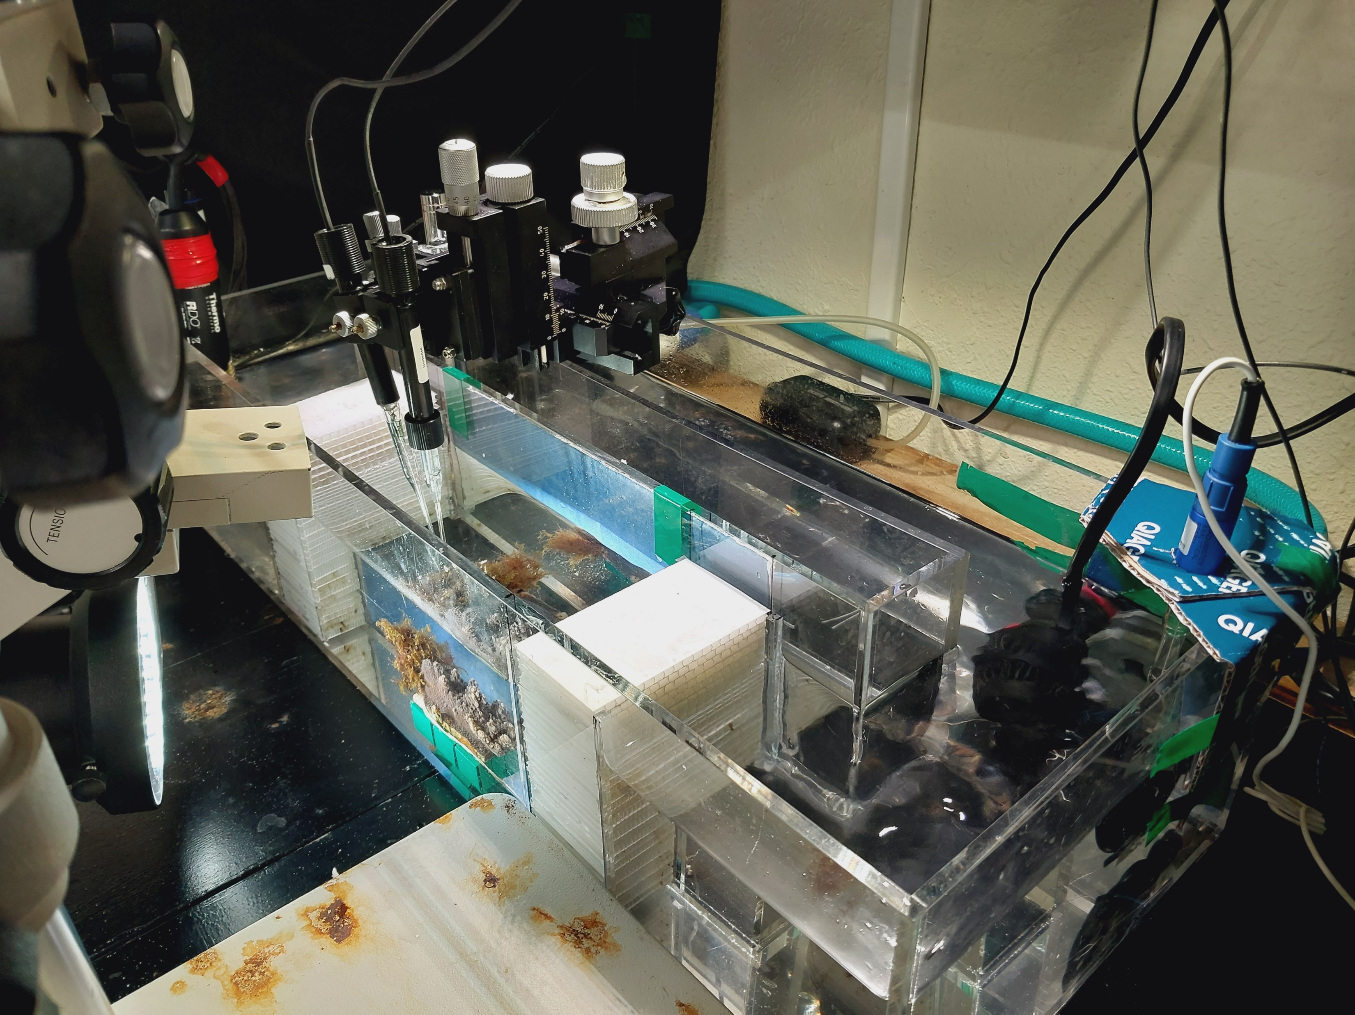

Slide 4


A front profile angle
Light source
(only day-time measurements)
~5 mol m² d⁻¹
z axis
fine-step z axis
y axis
x axis
Flow-straightener
Flow-straightener
O₂
pH
15 cm
water flow ~3 cm s⁻¹
turf algae
coral tissue
water flow ~3 cm s⁻¹
stand
B top-down angle
60 cm
fresh filtered seawater
tank seawater outflow
Air pump
water pump
water flow ~3 cm s⁻¹
pH reference electrode
water pump
DO
pH
temp.
25 cm
ground wire for O₂ sensor
water flow
water flow
60 cm

Slide 5
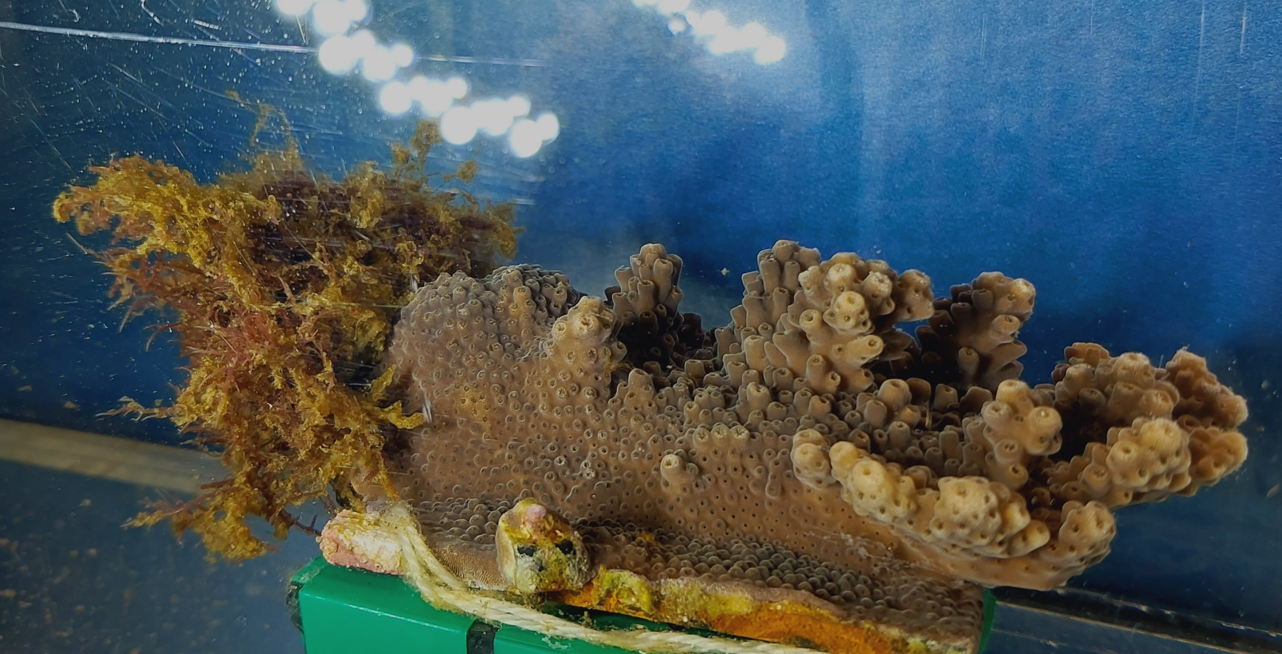
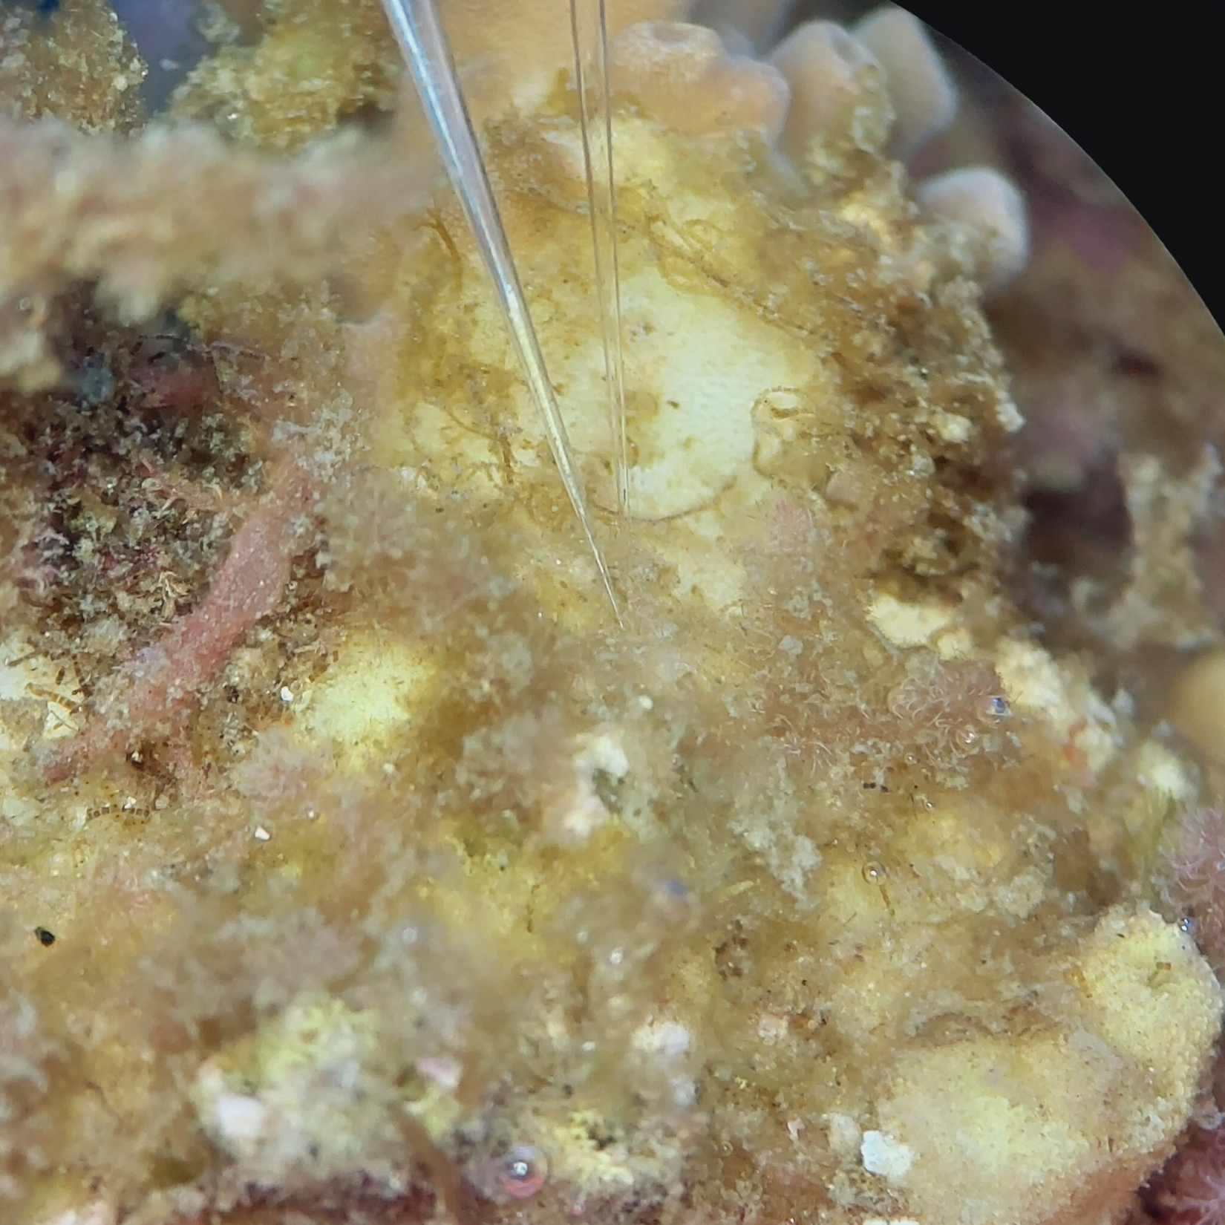
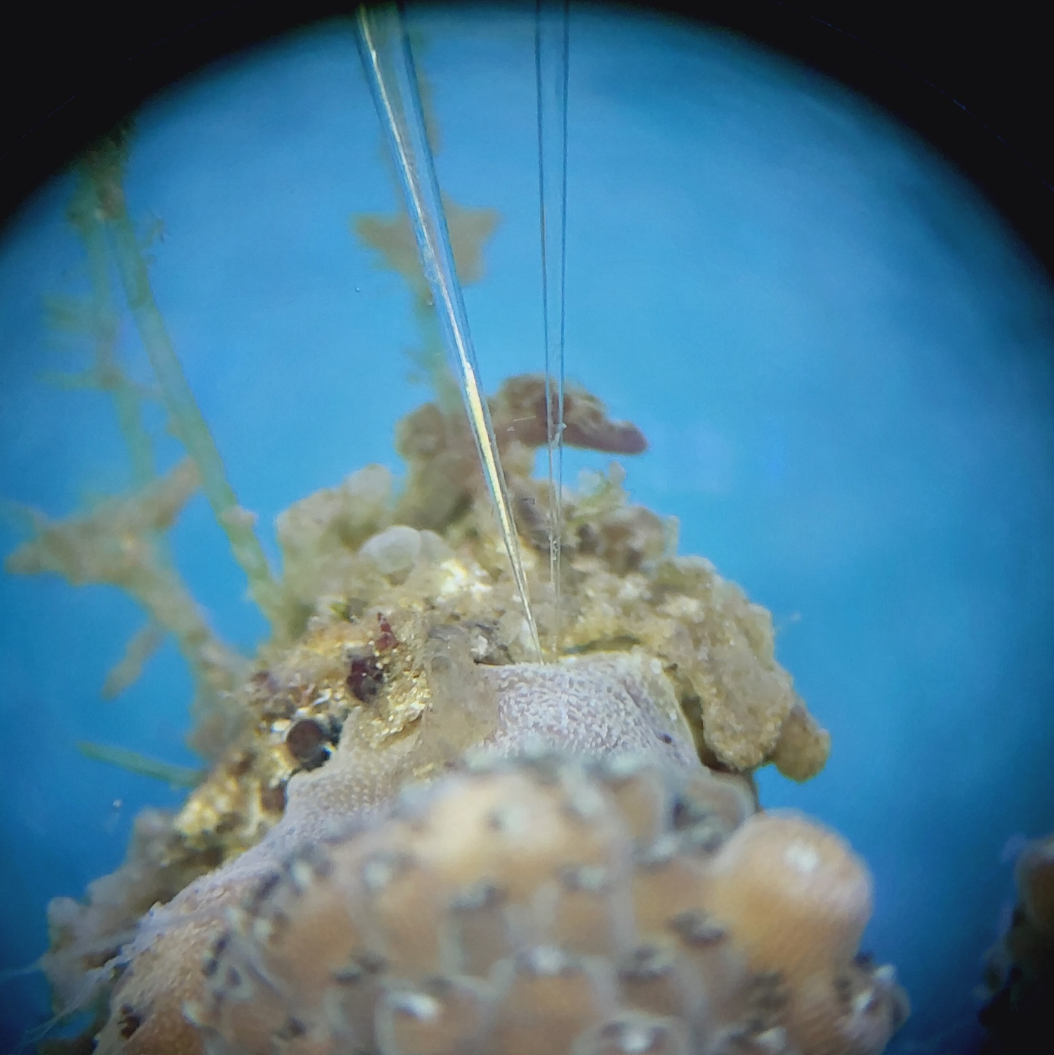
Coral-algae community
measurement locations
Turf algal side (2 measurements)
Coral tissue side (2 measurements)
water flow

Slide 6
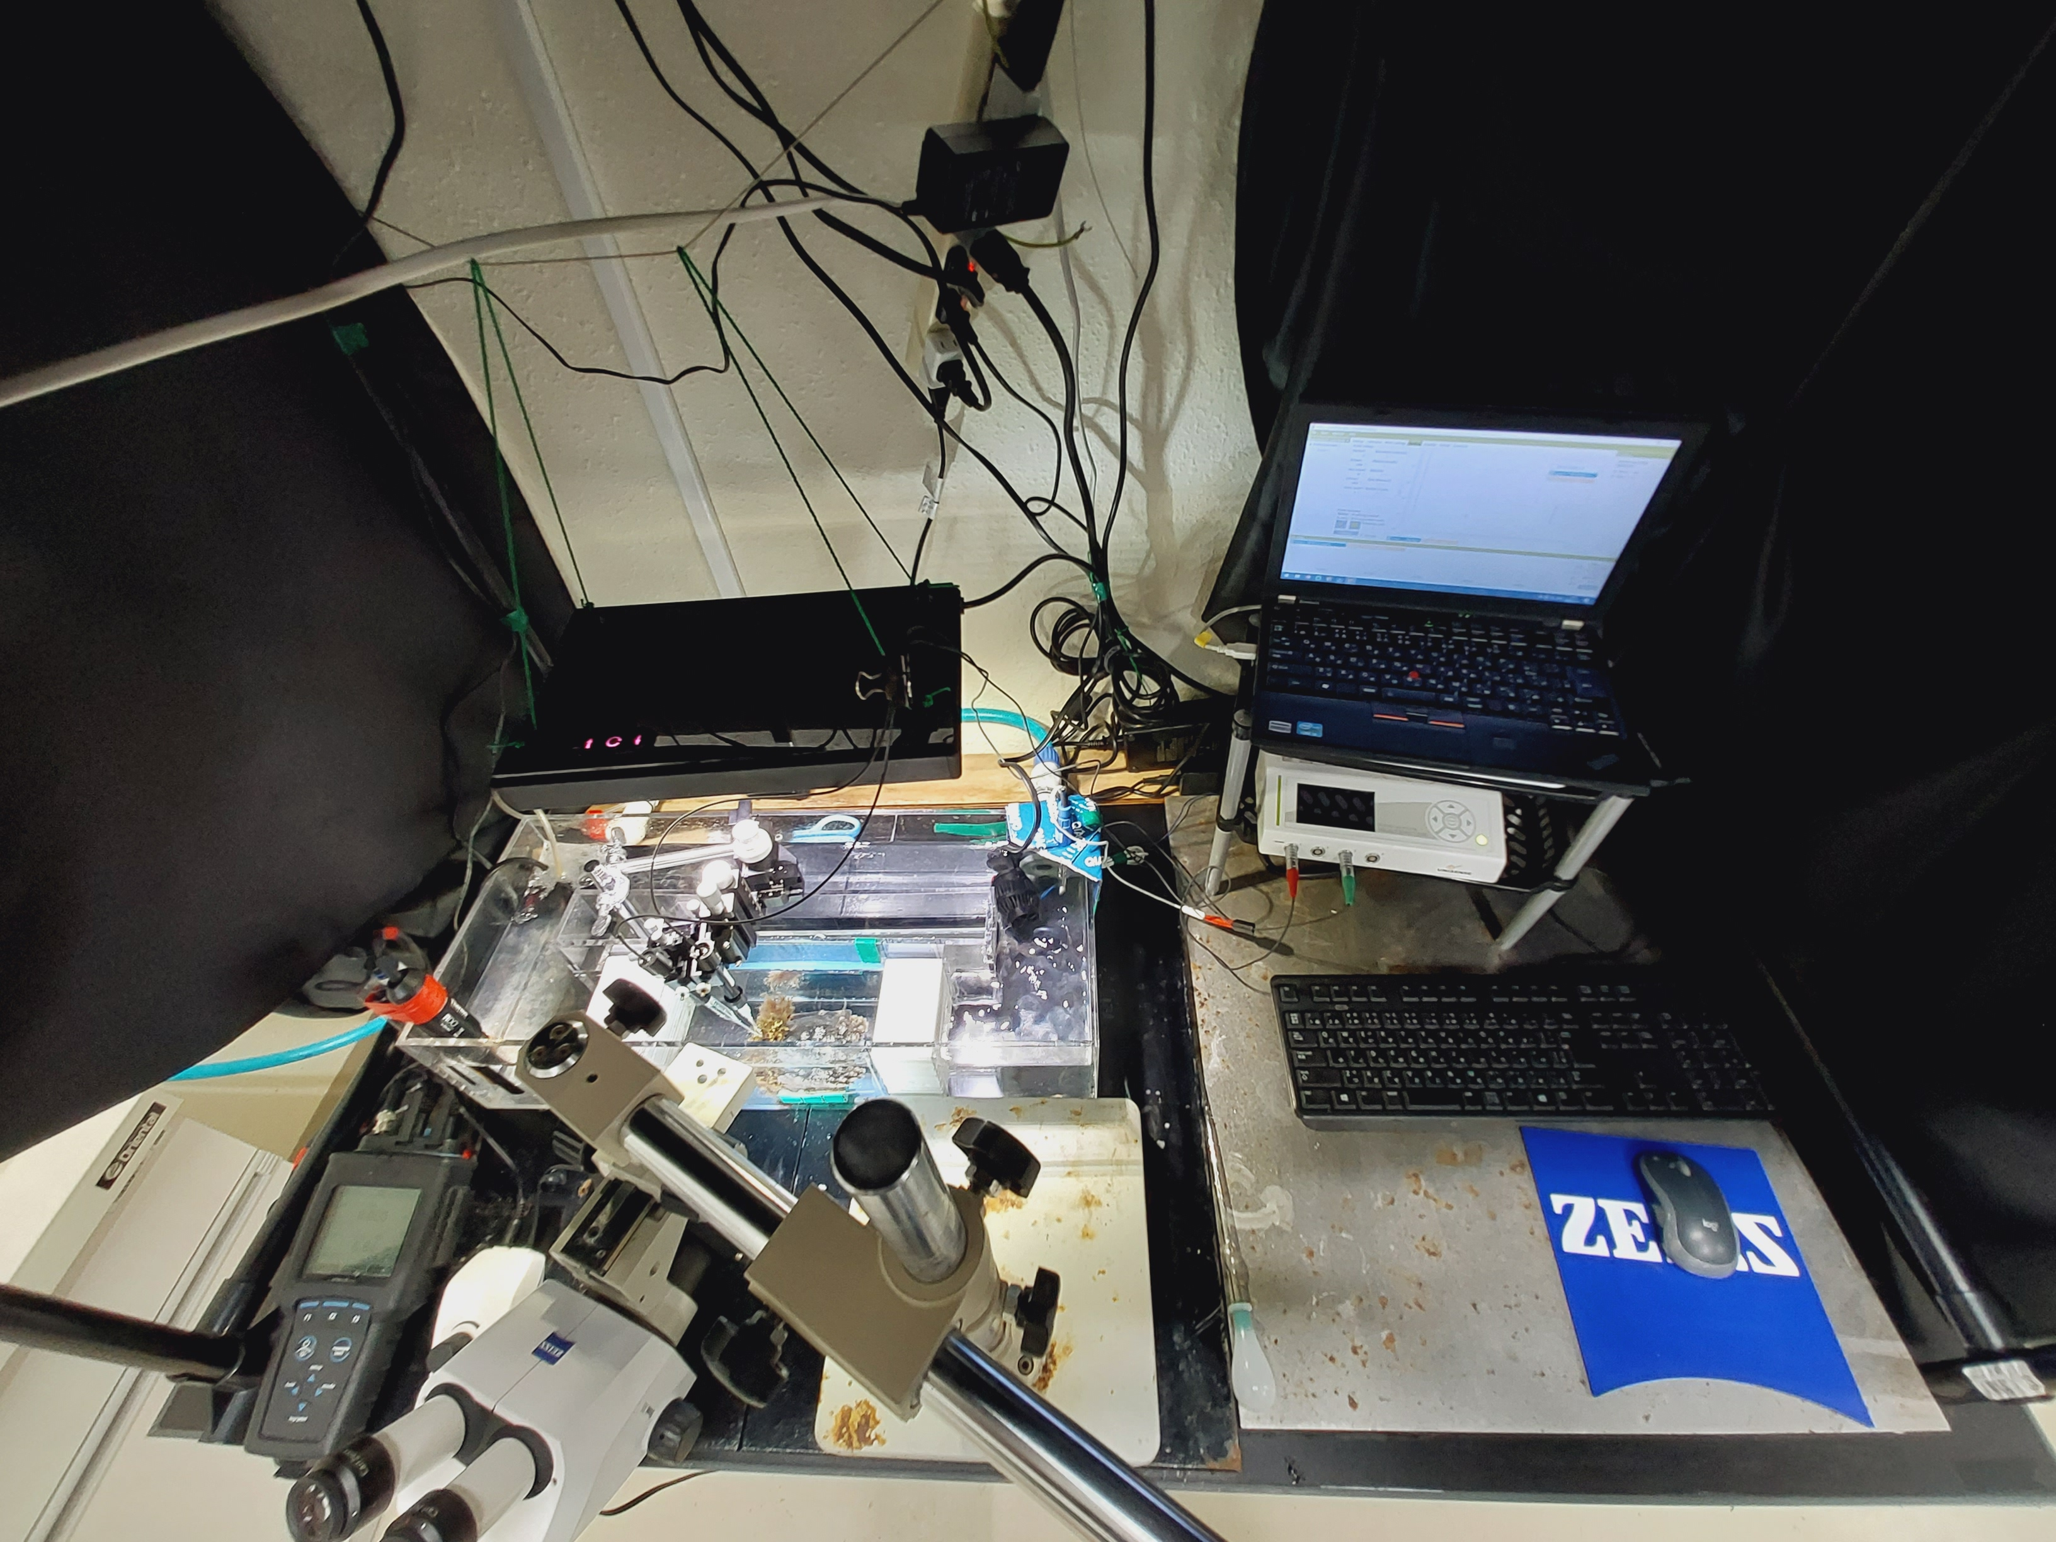

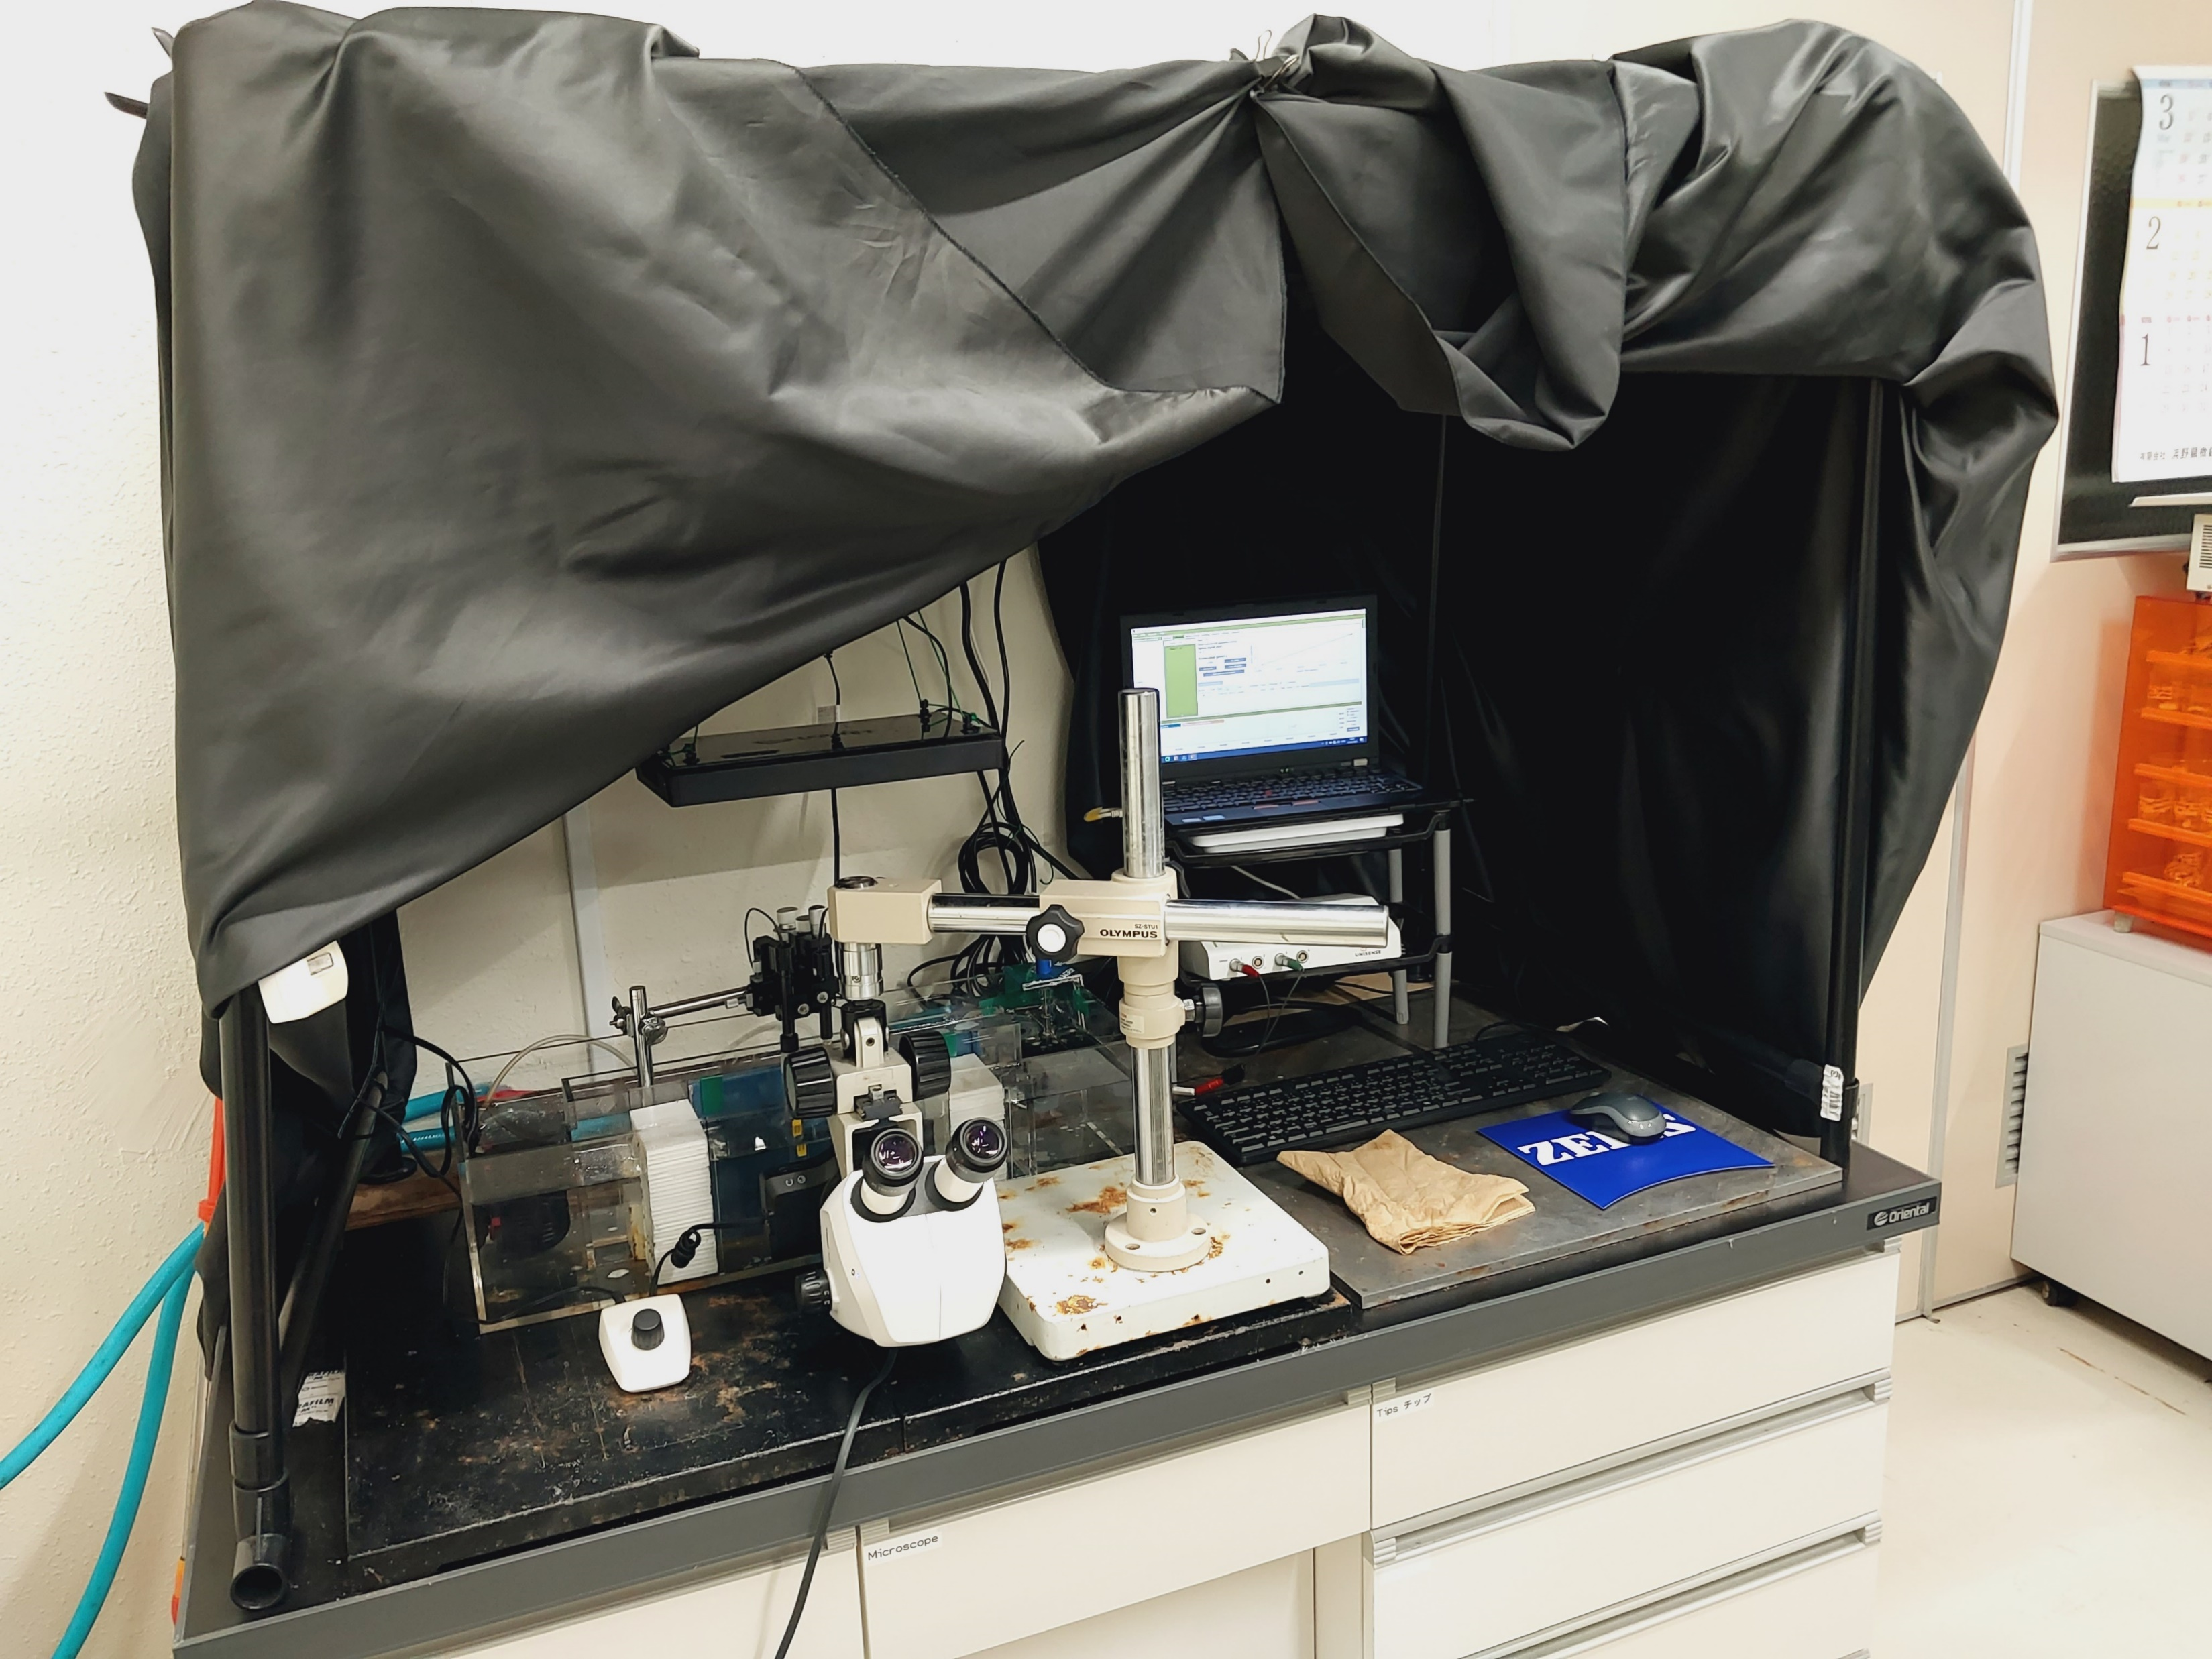
A
B
C

Slide 7
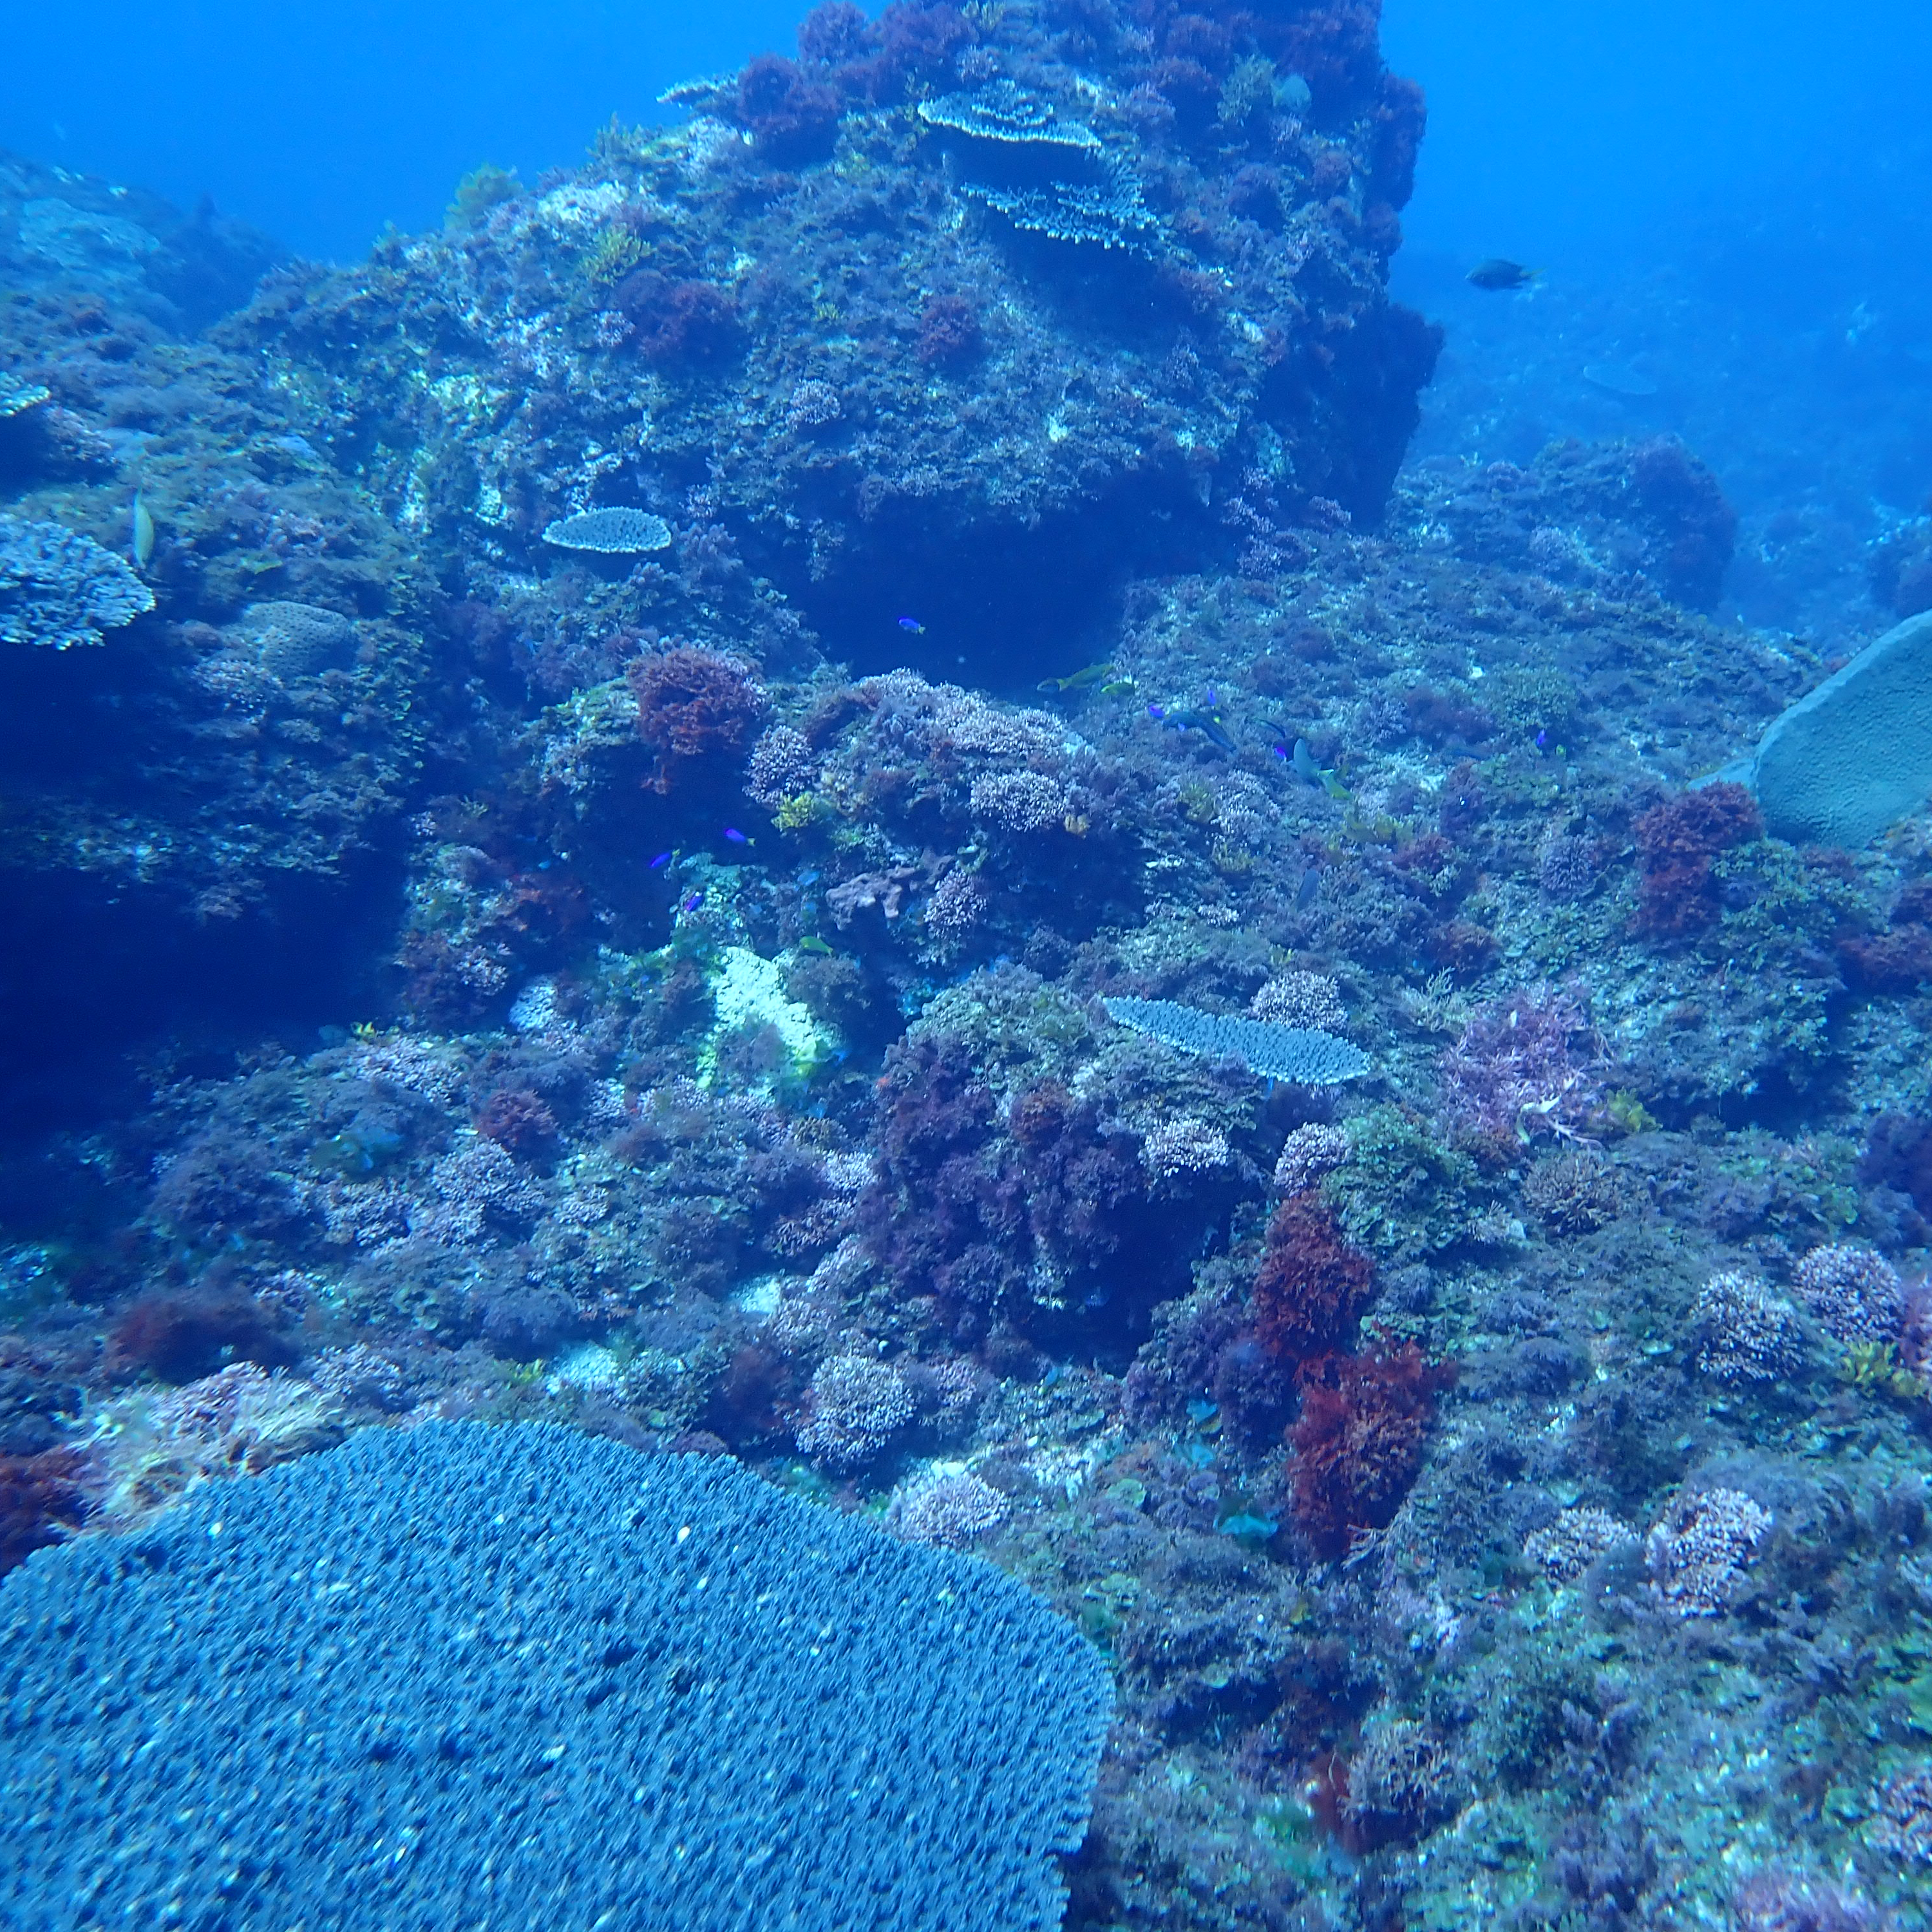
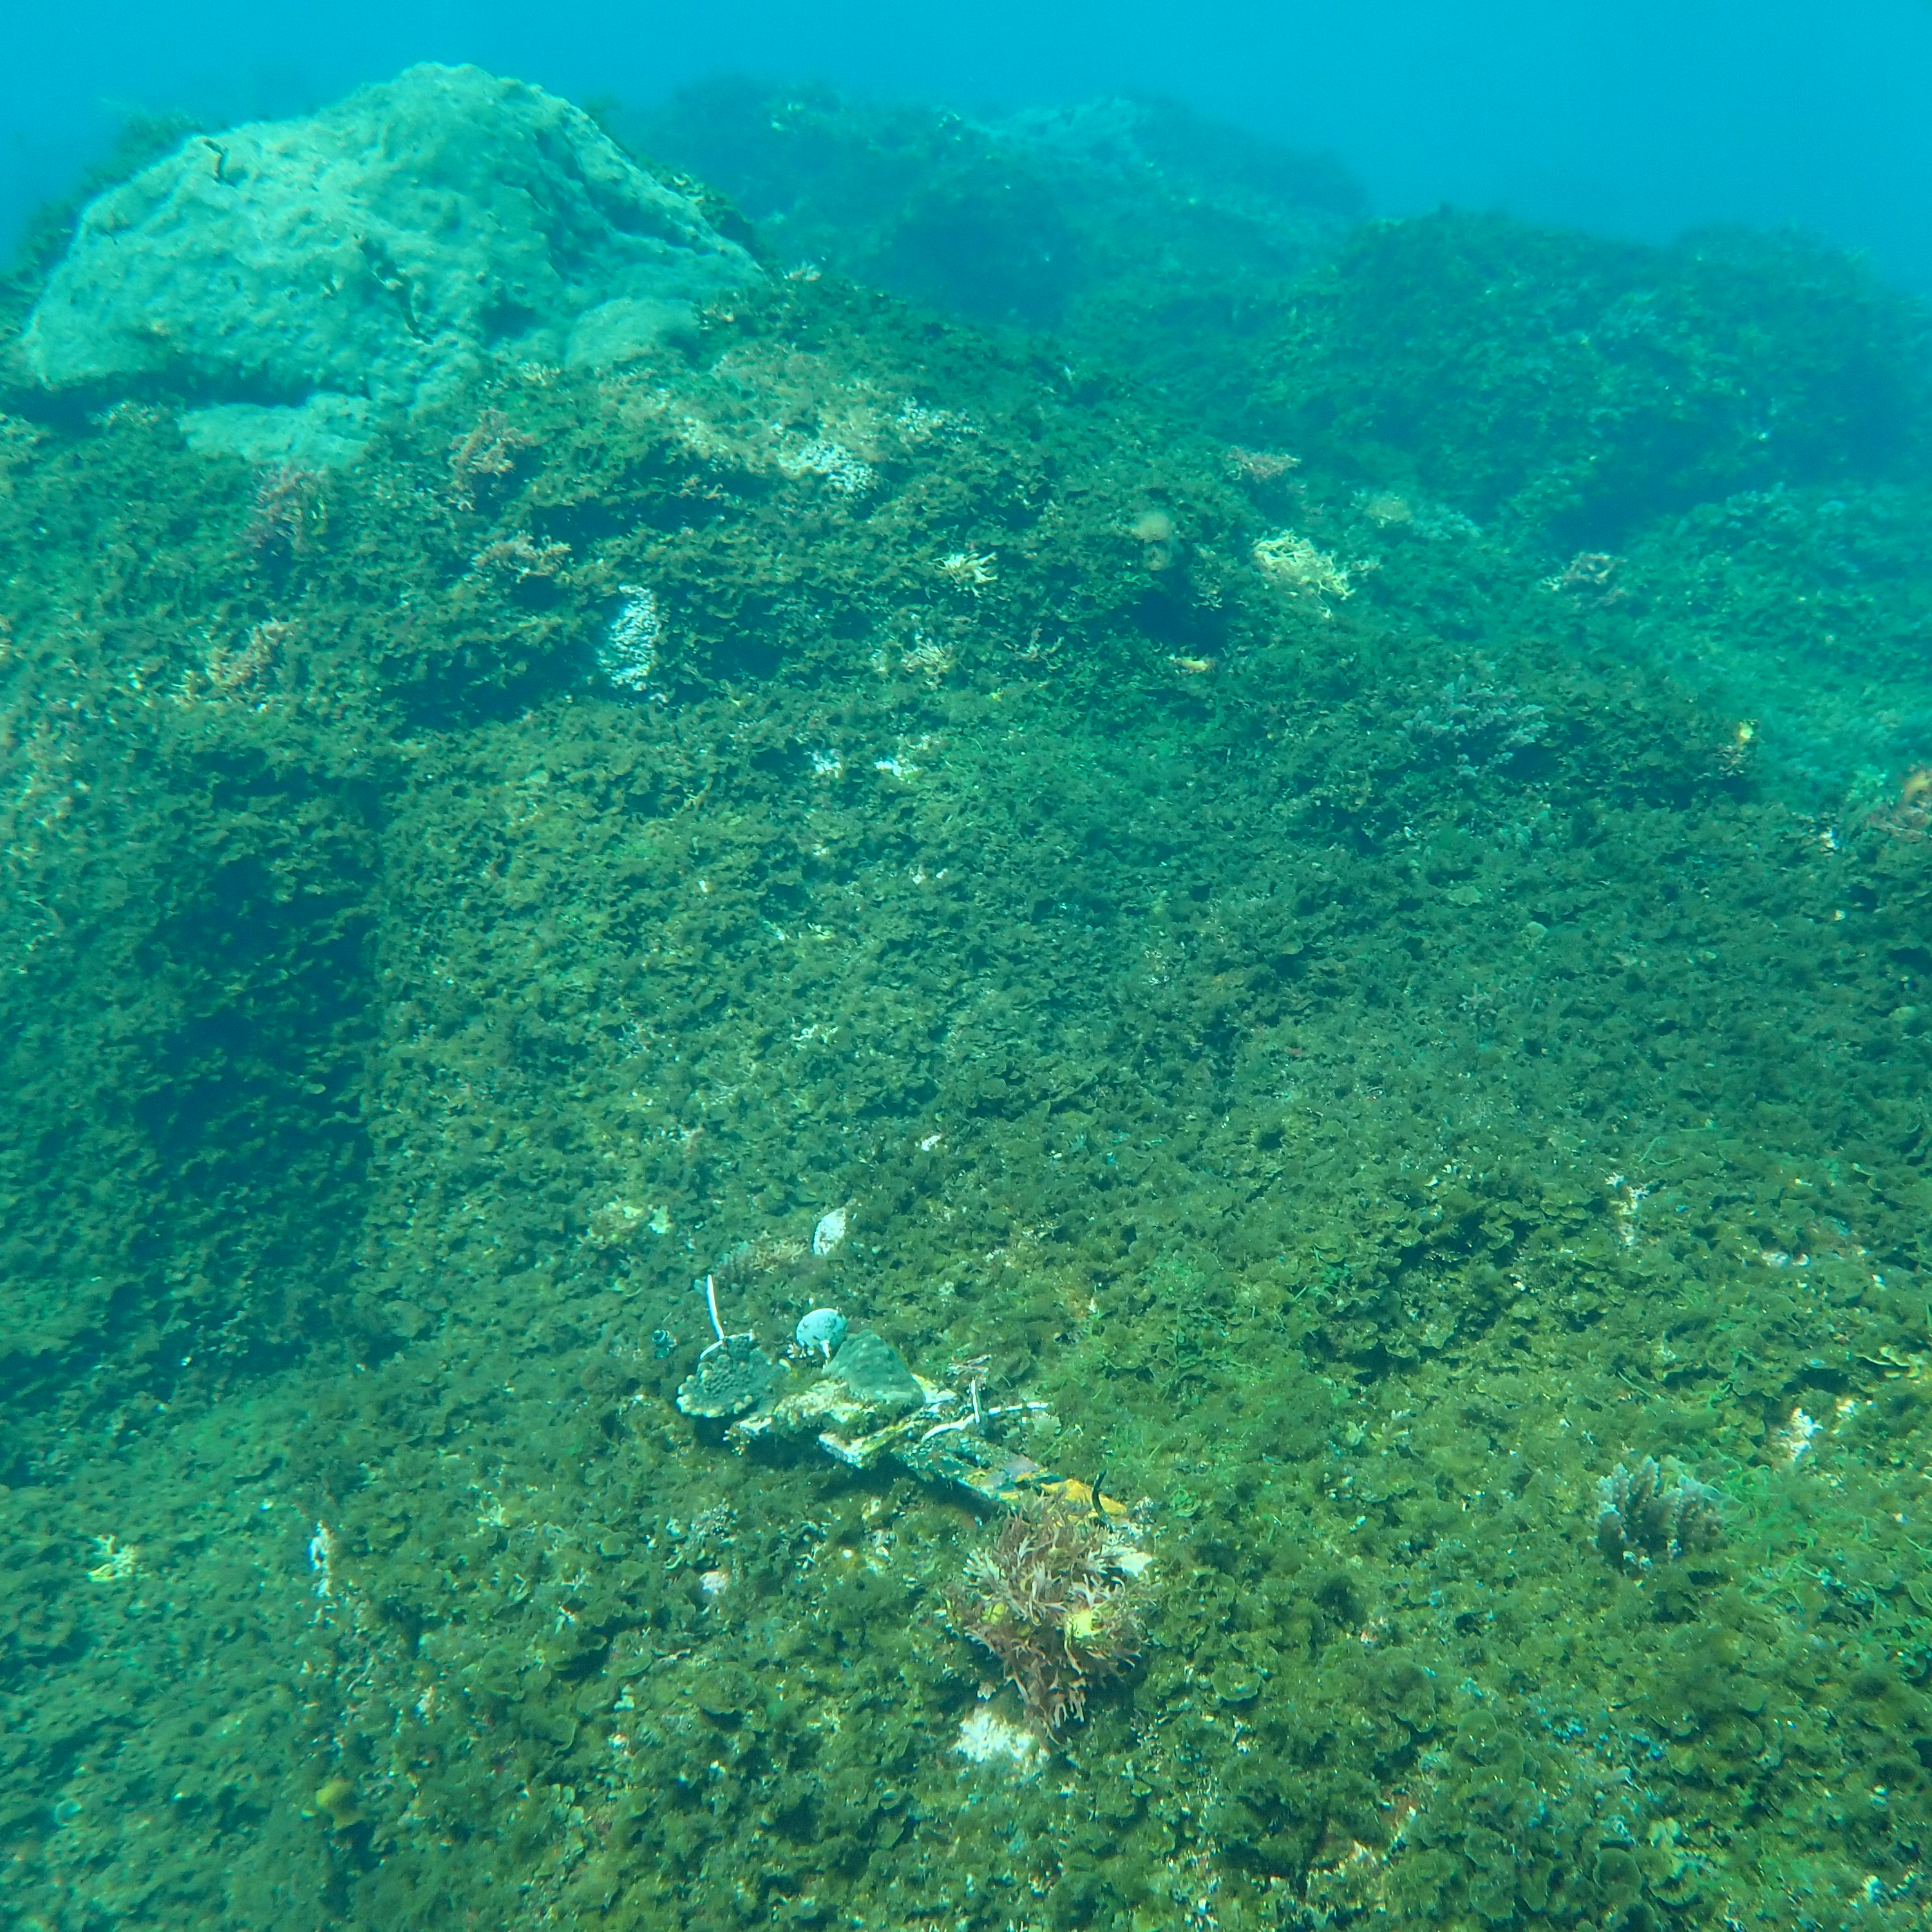
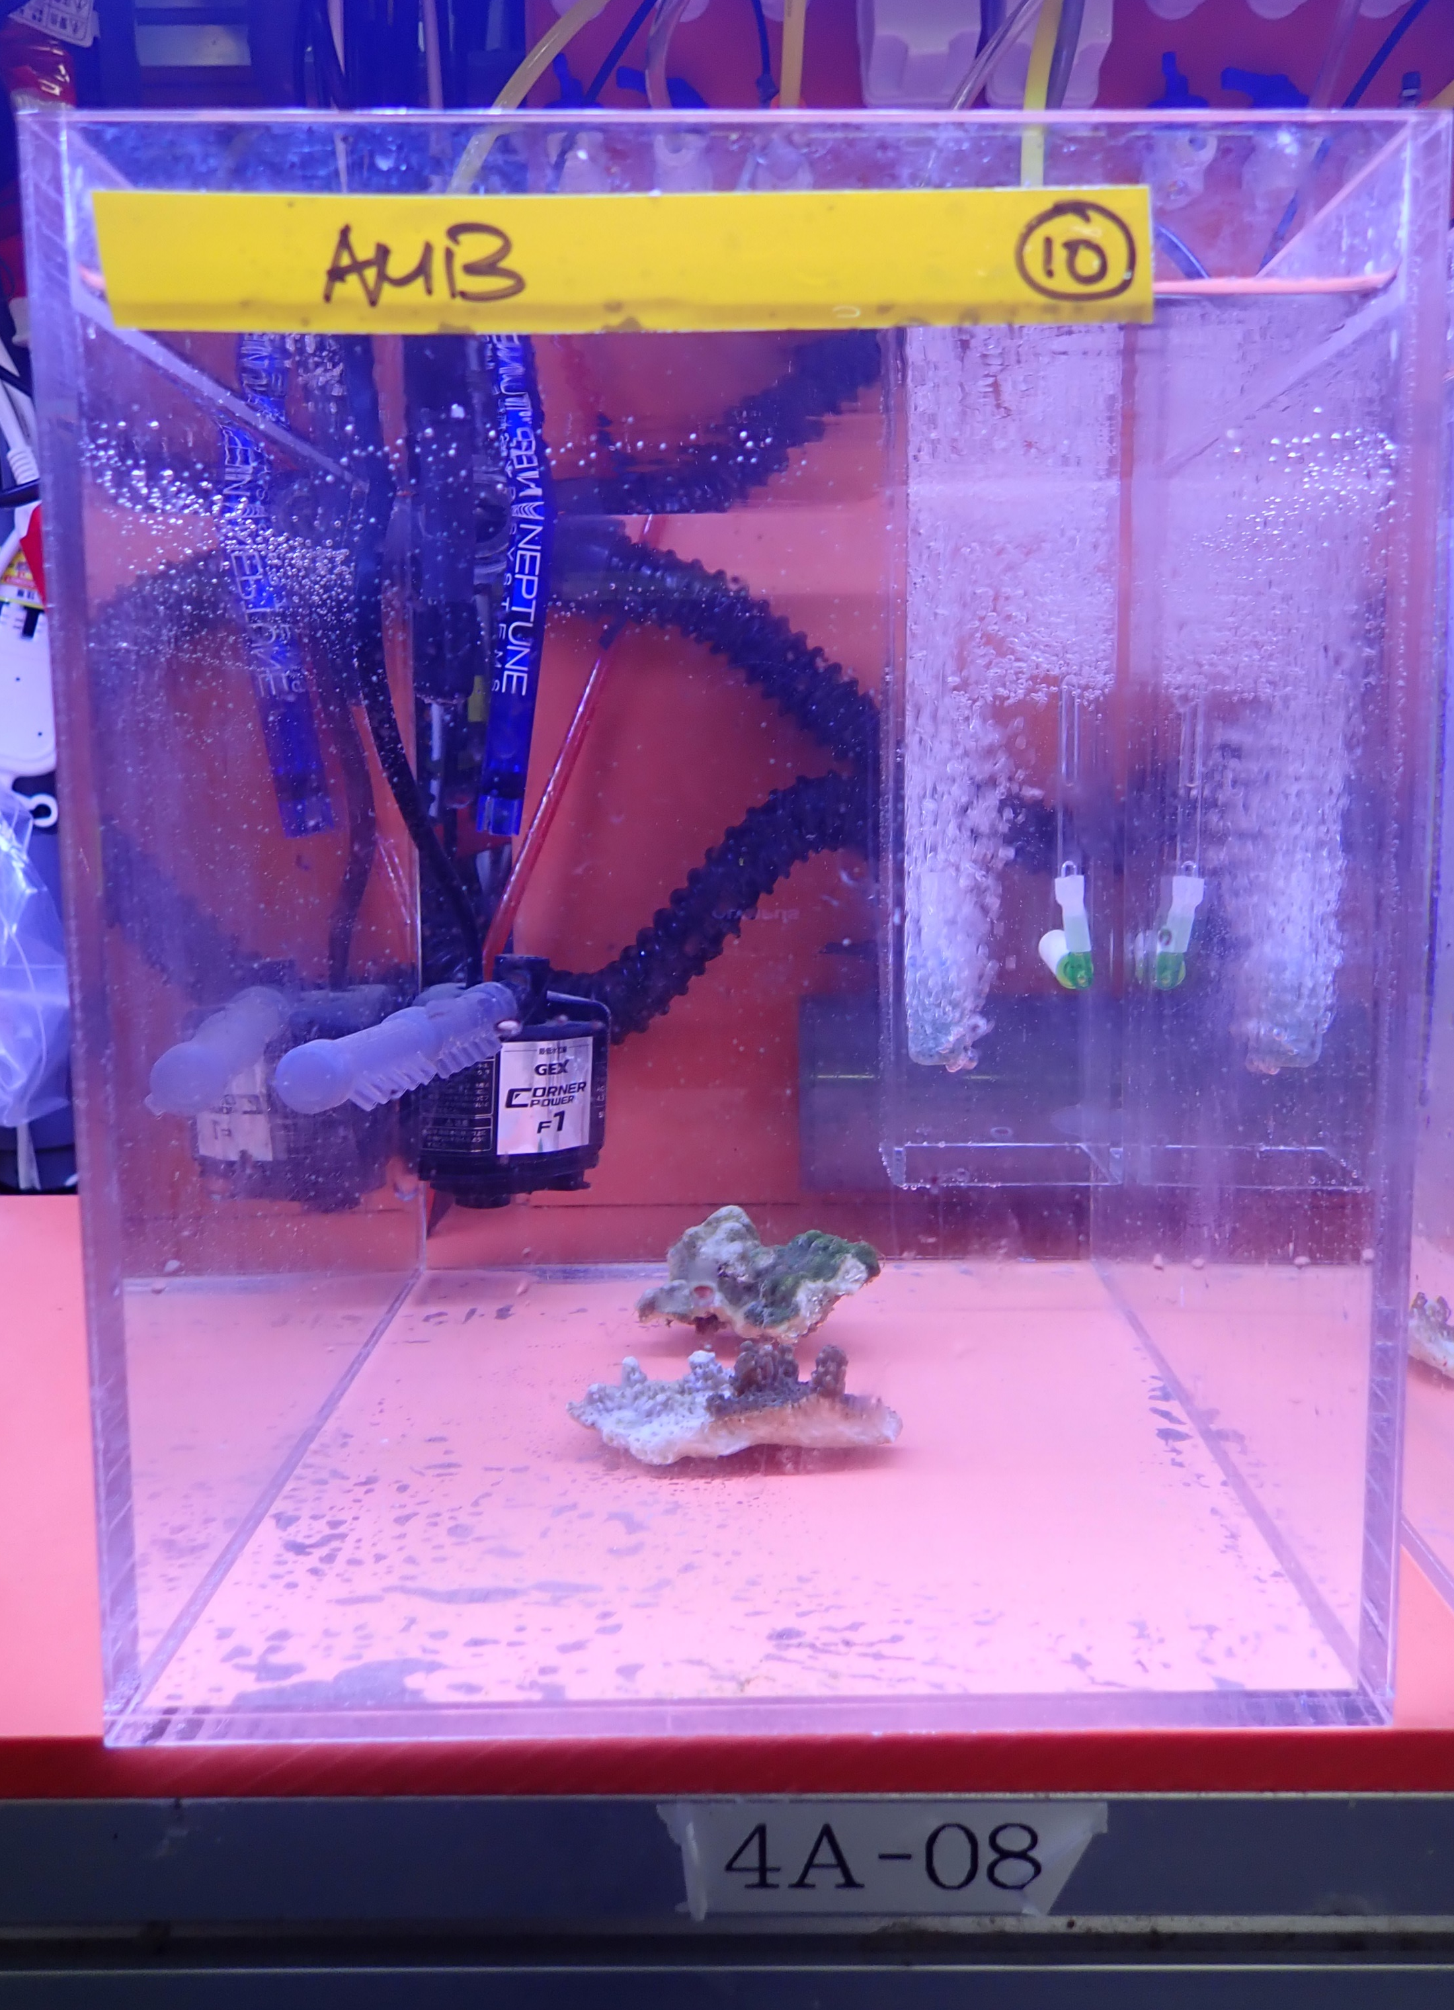
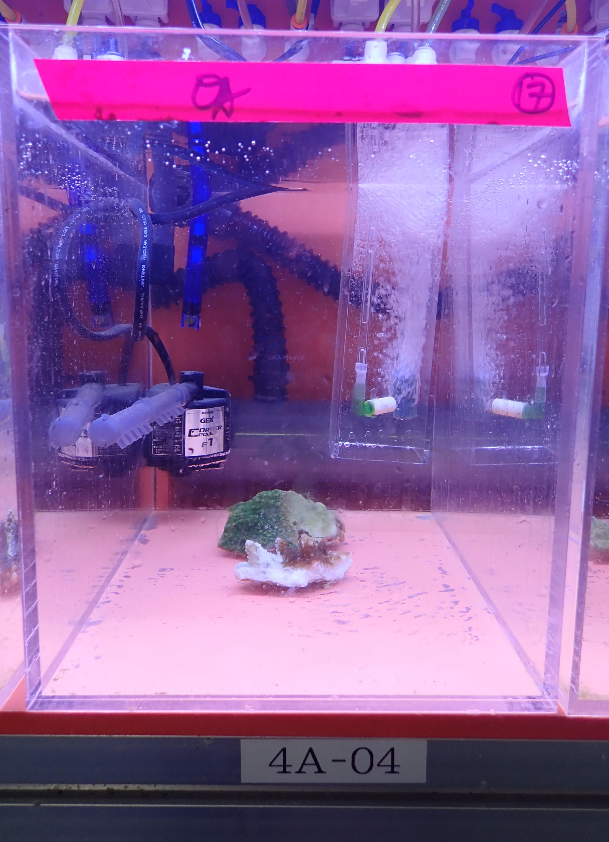
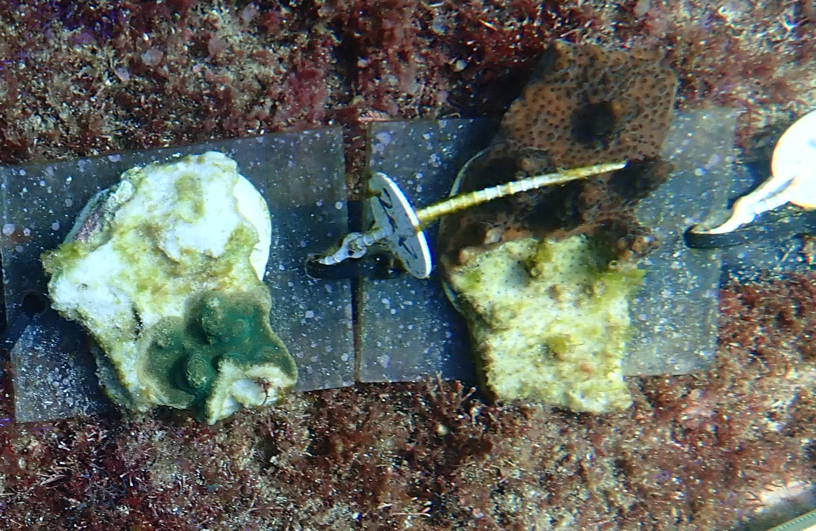
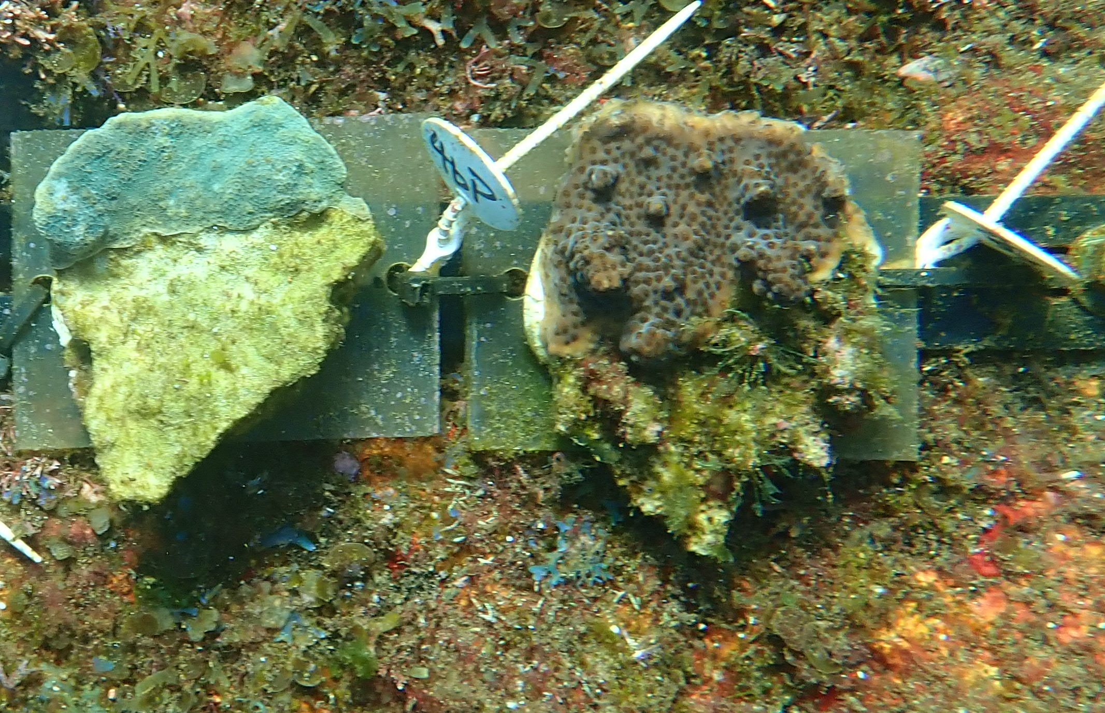
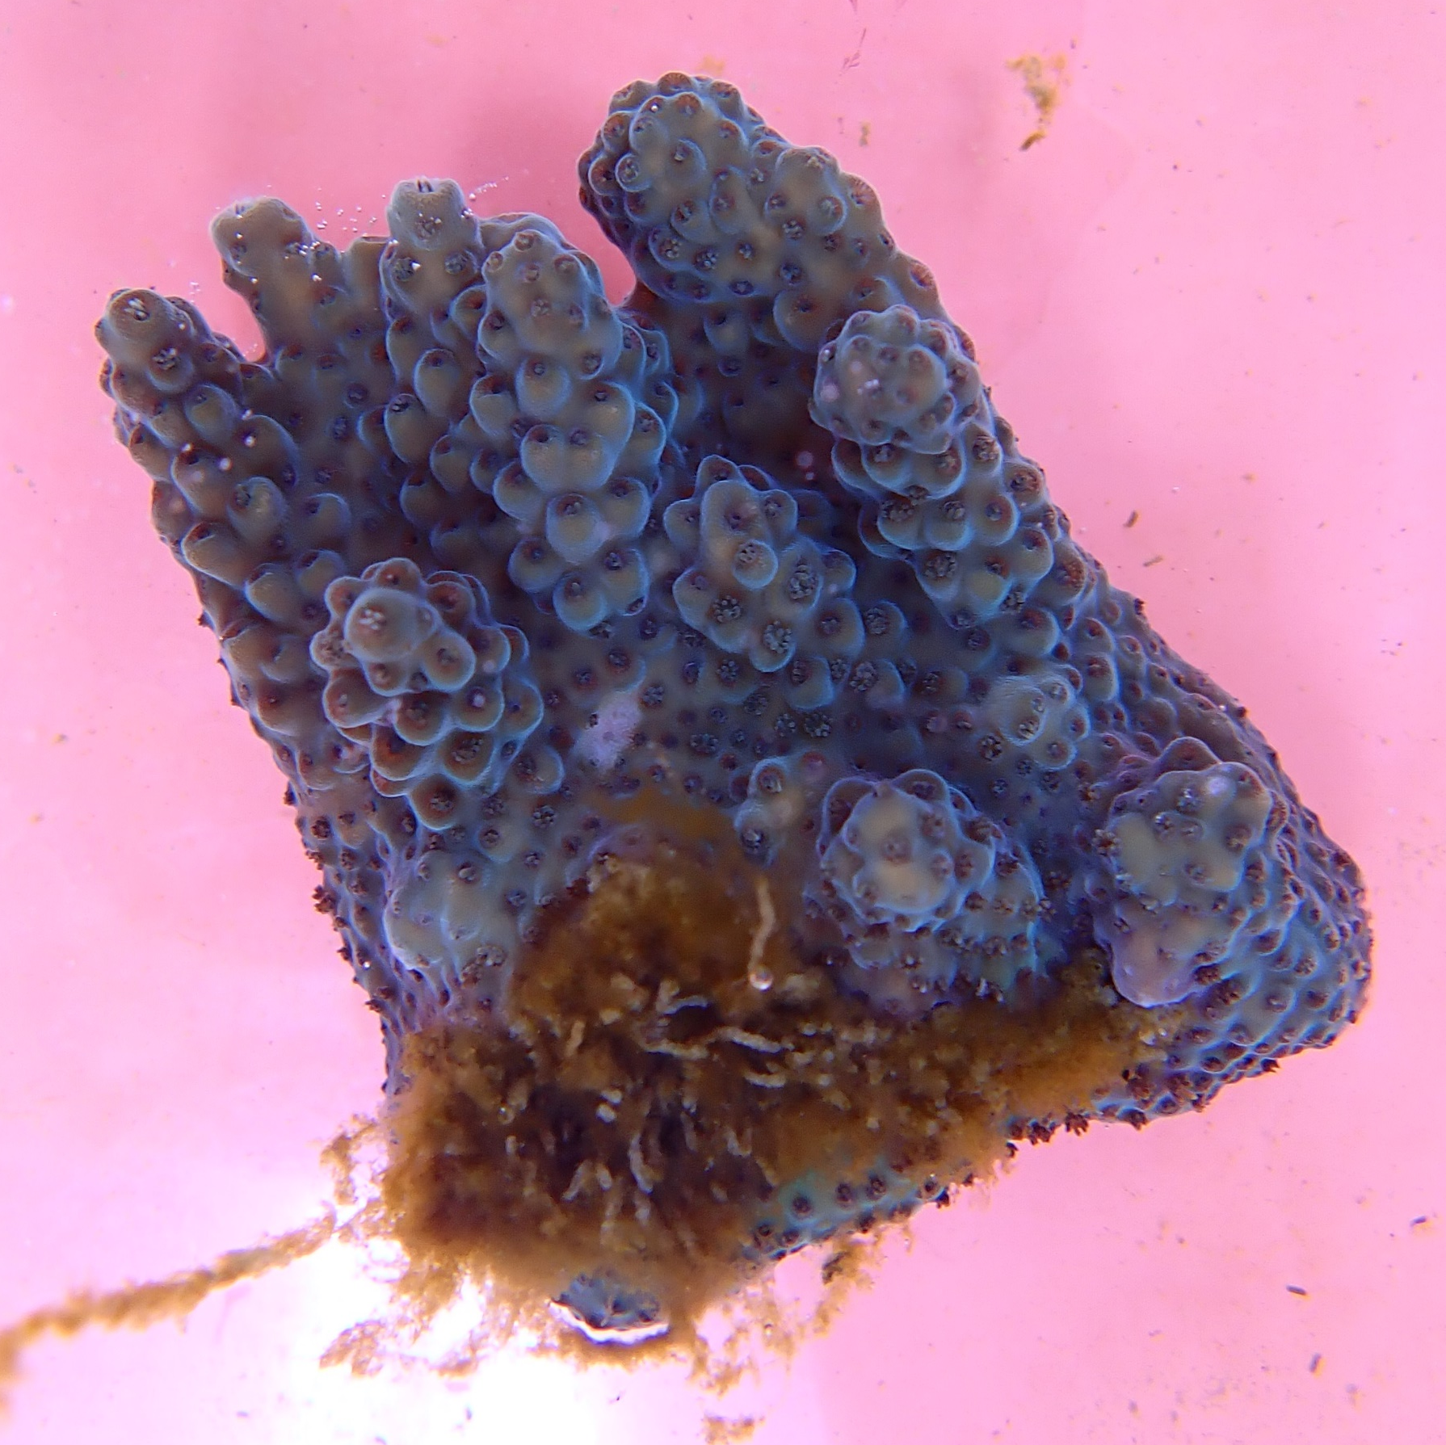
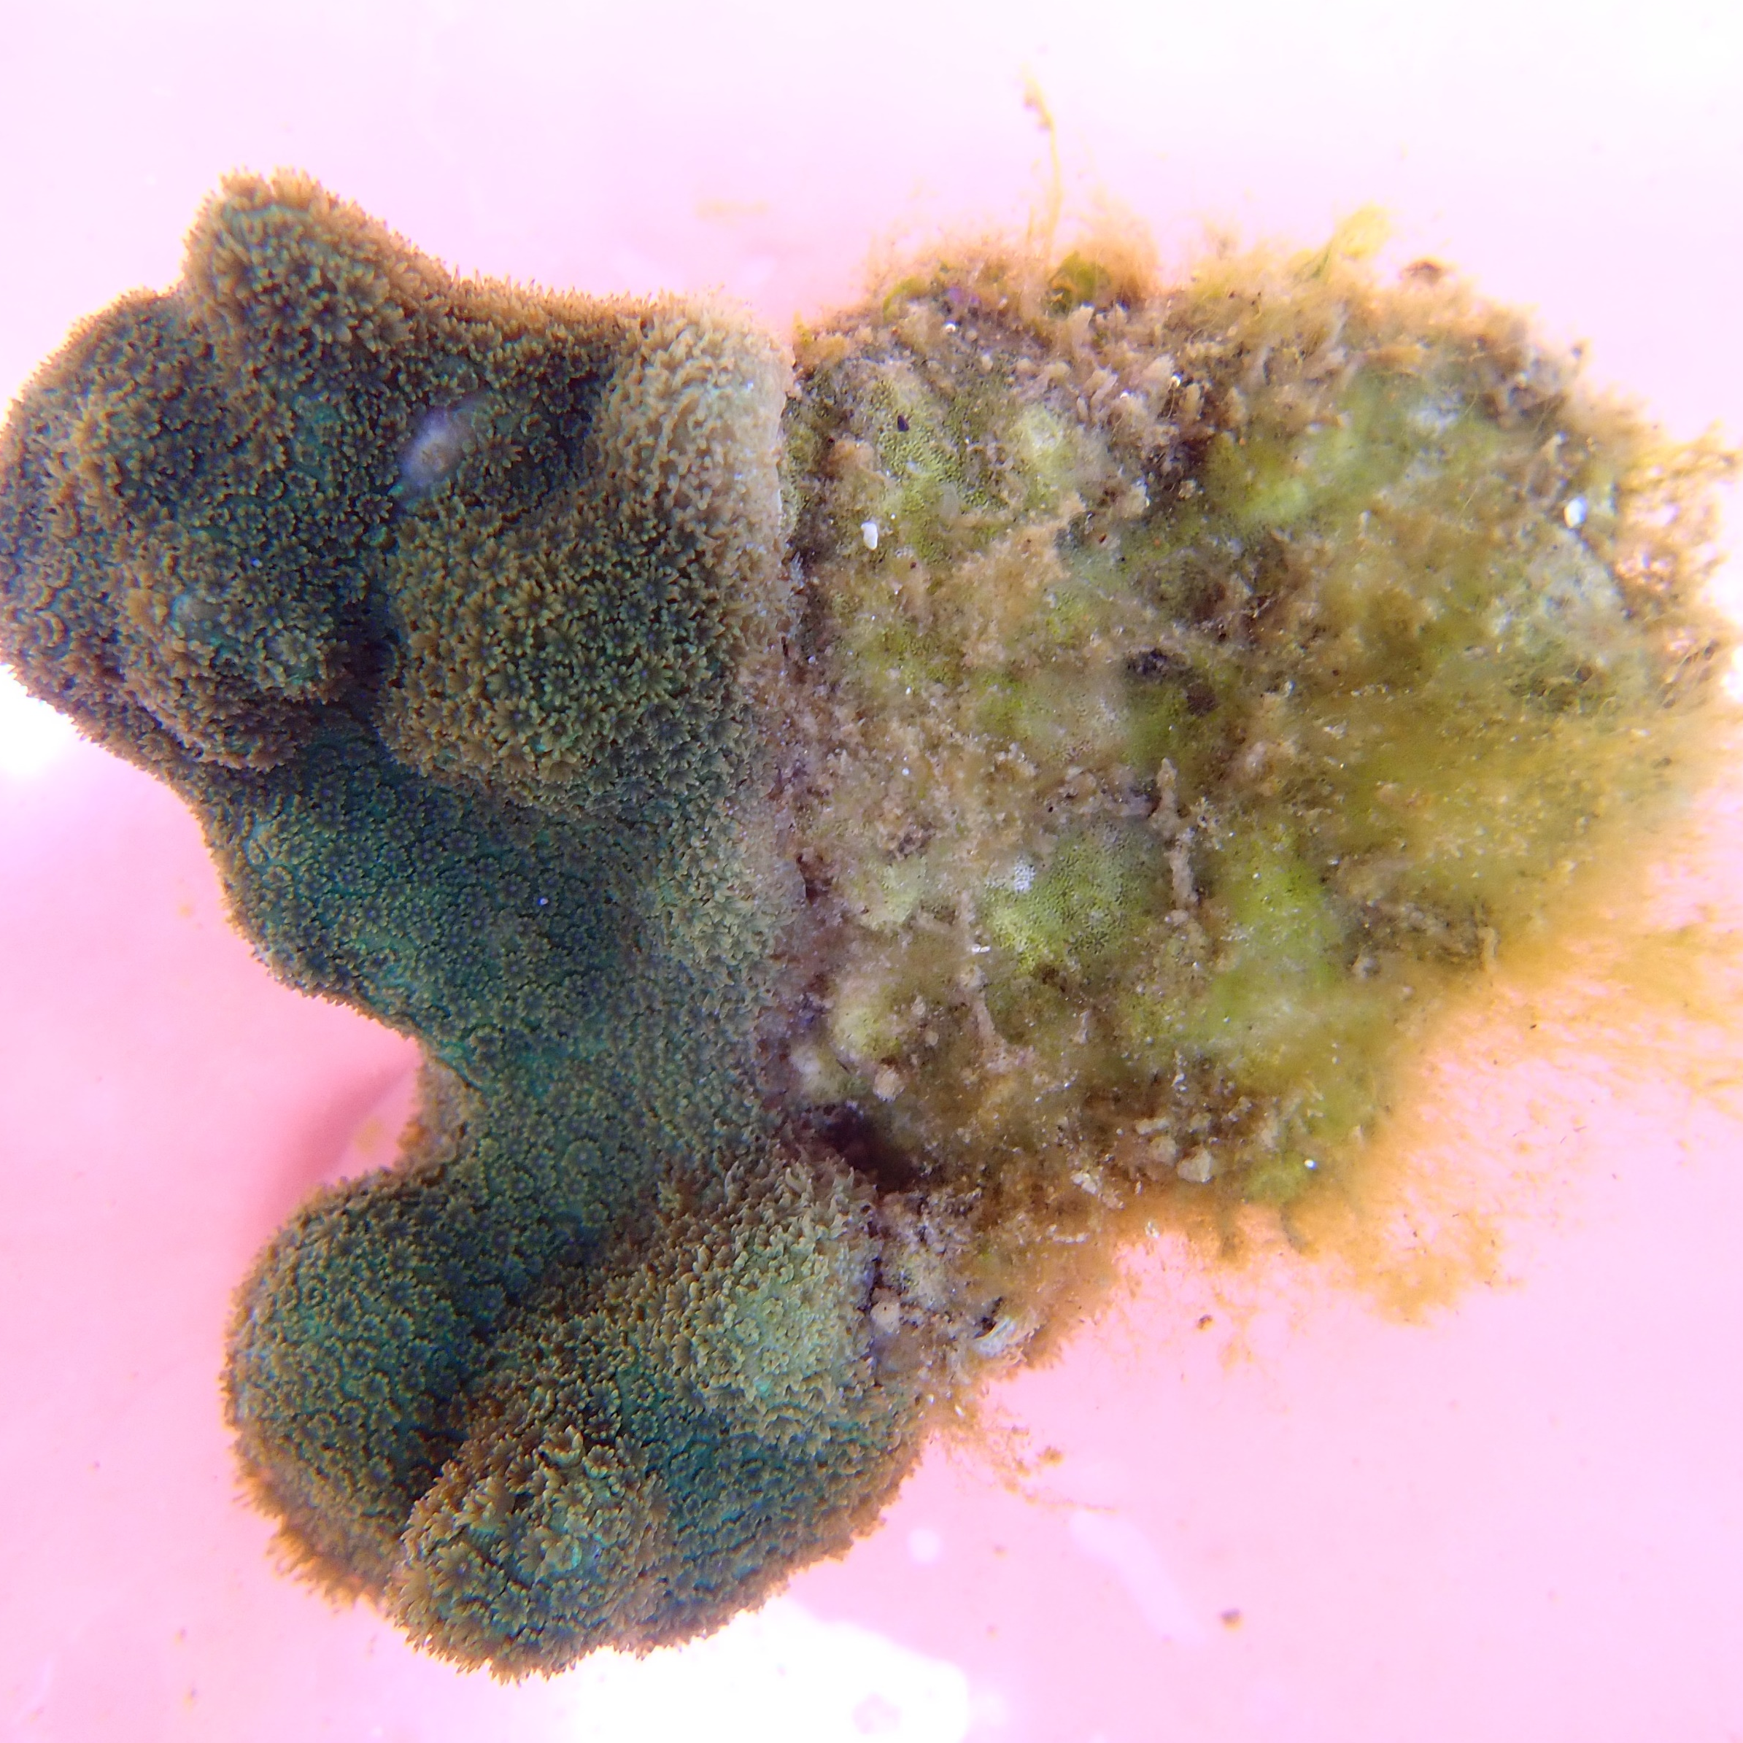
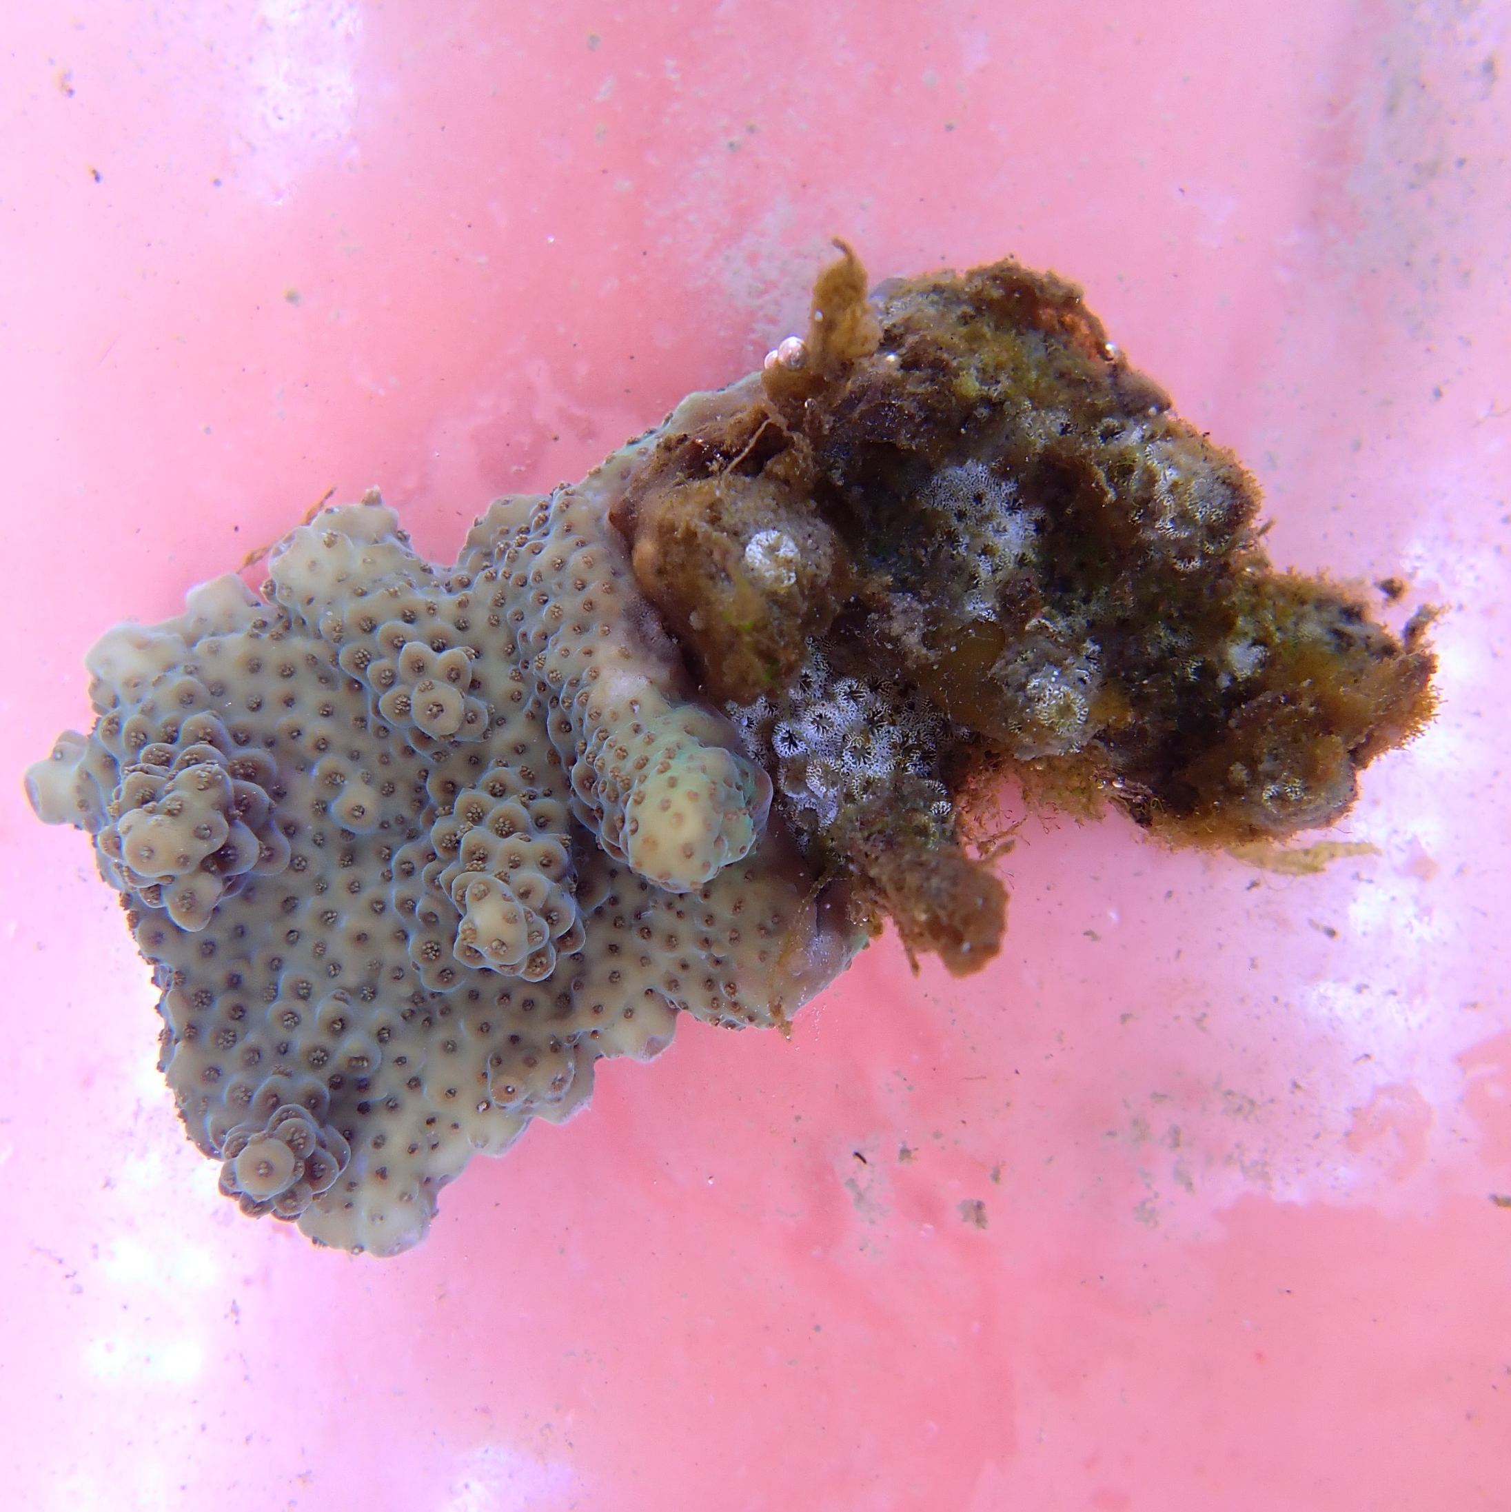
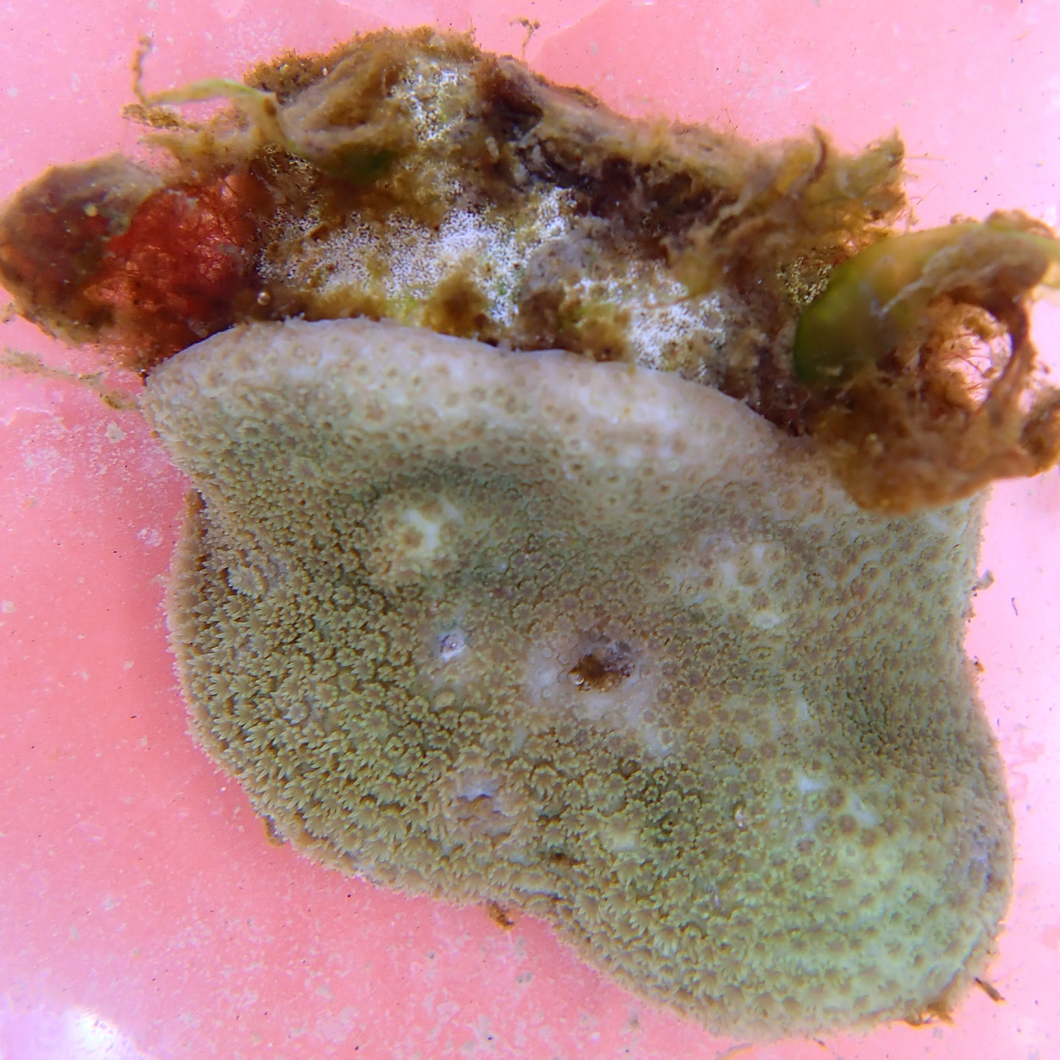
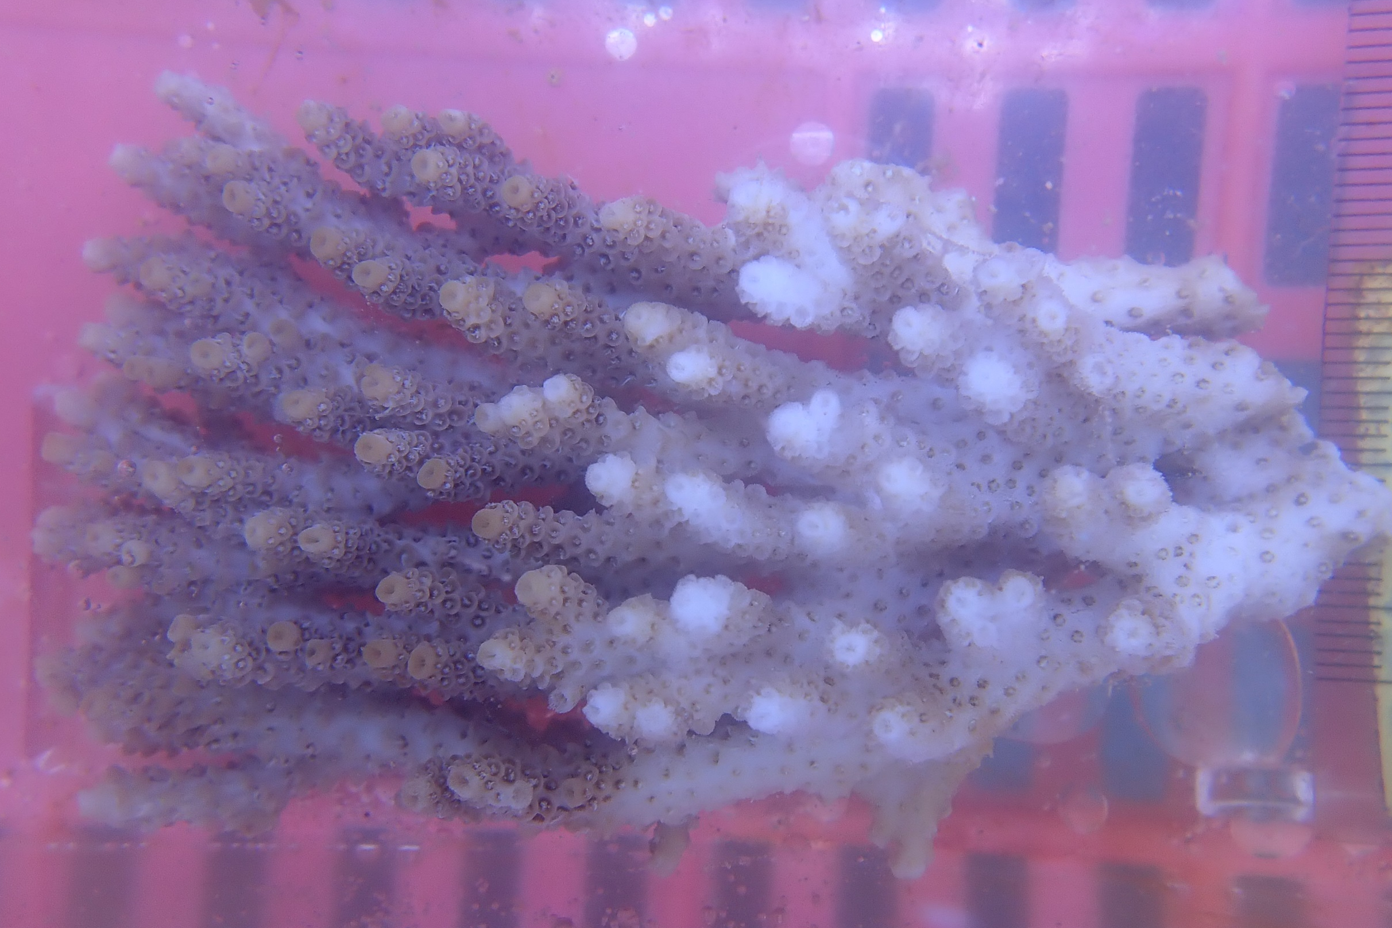
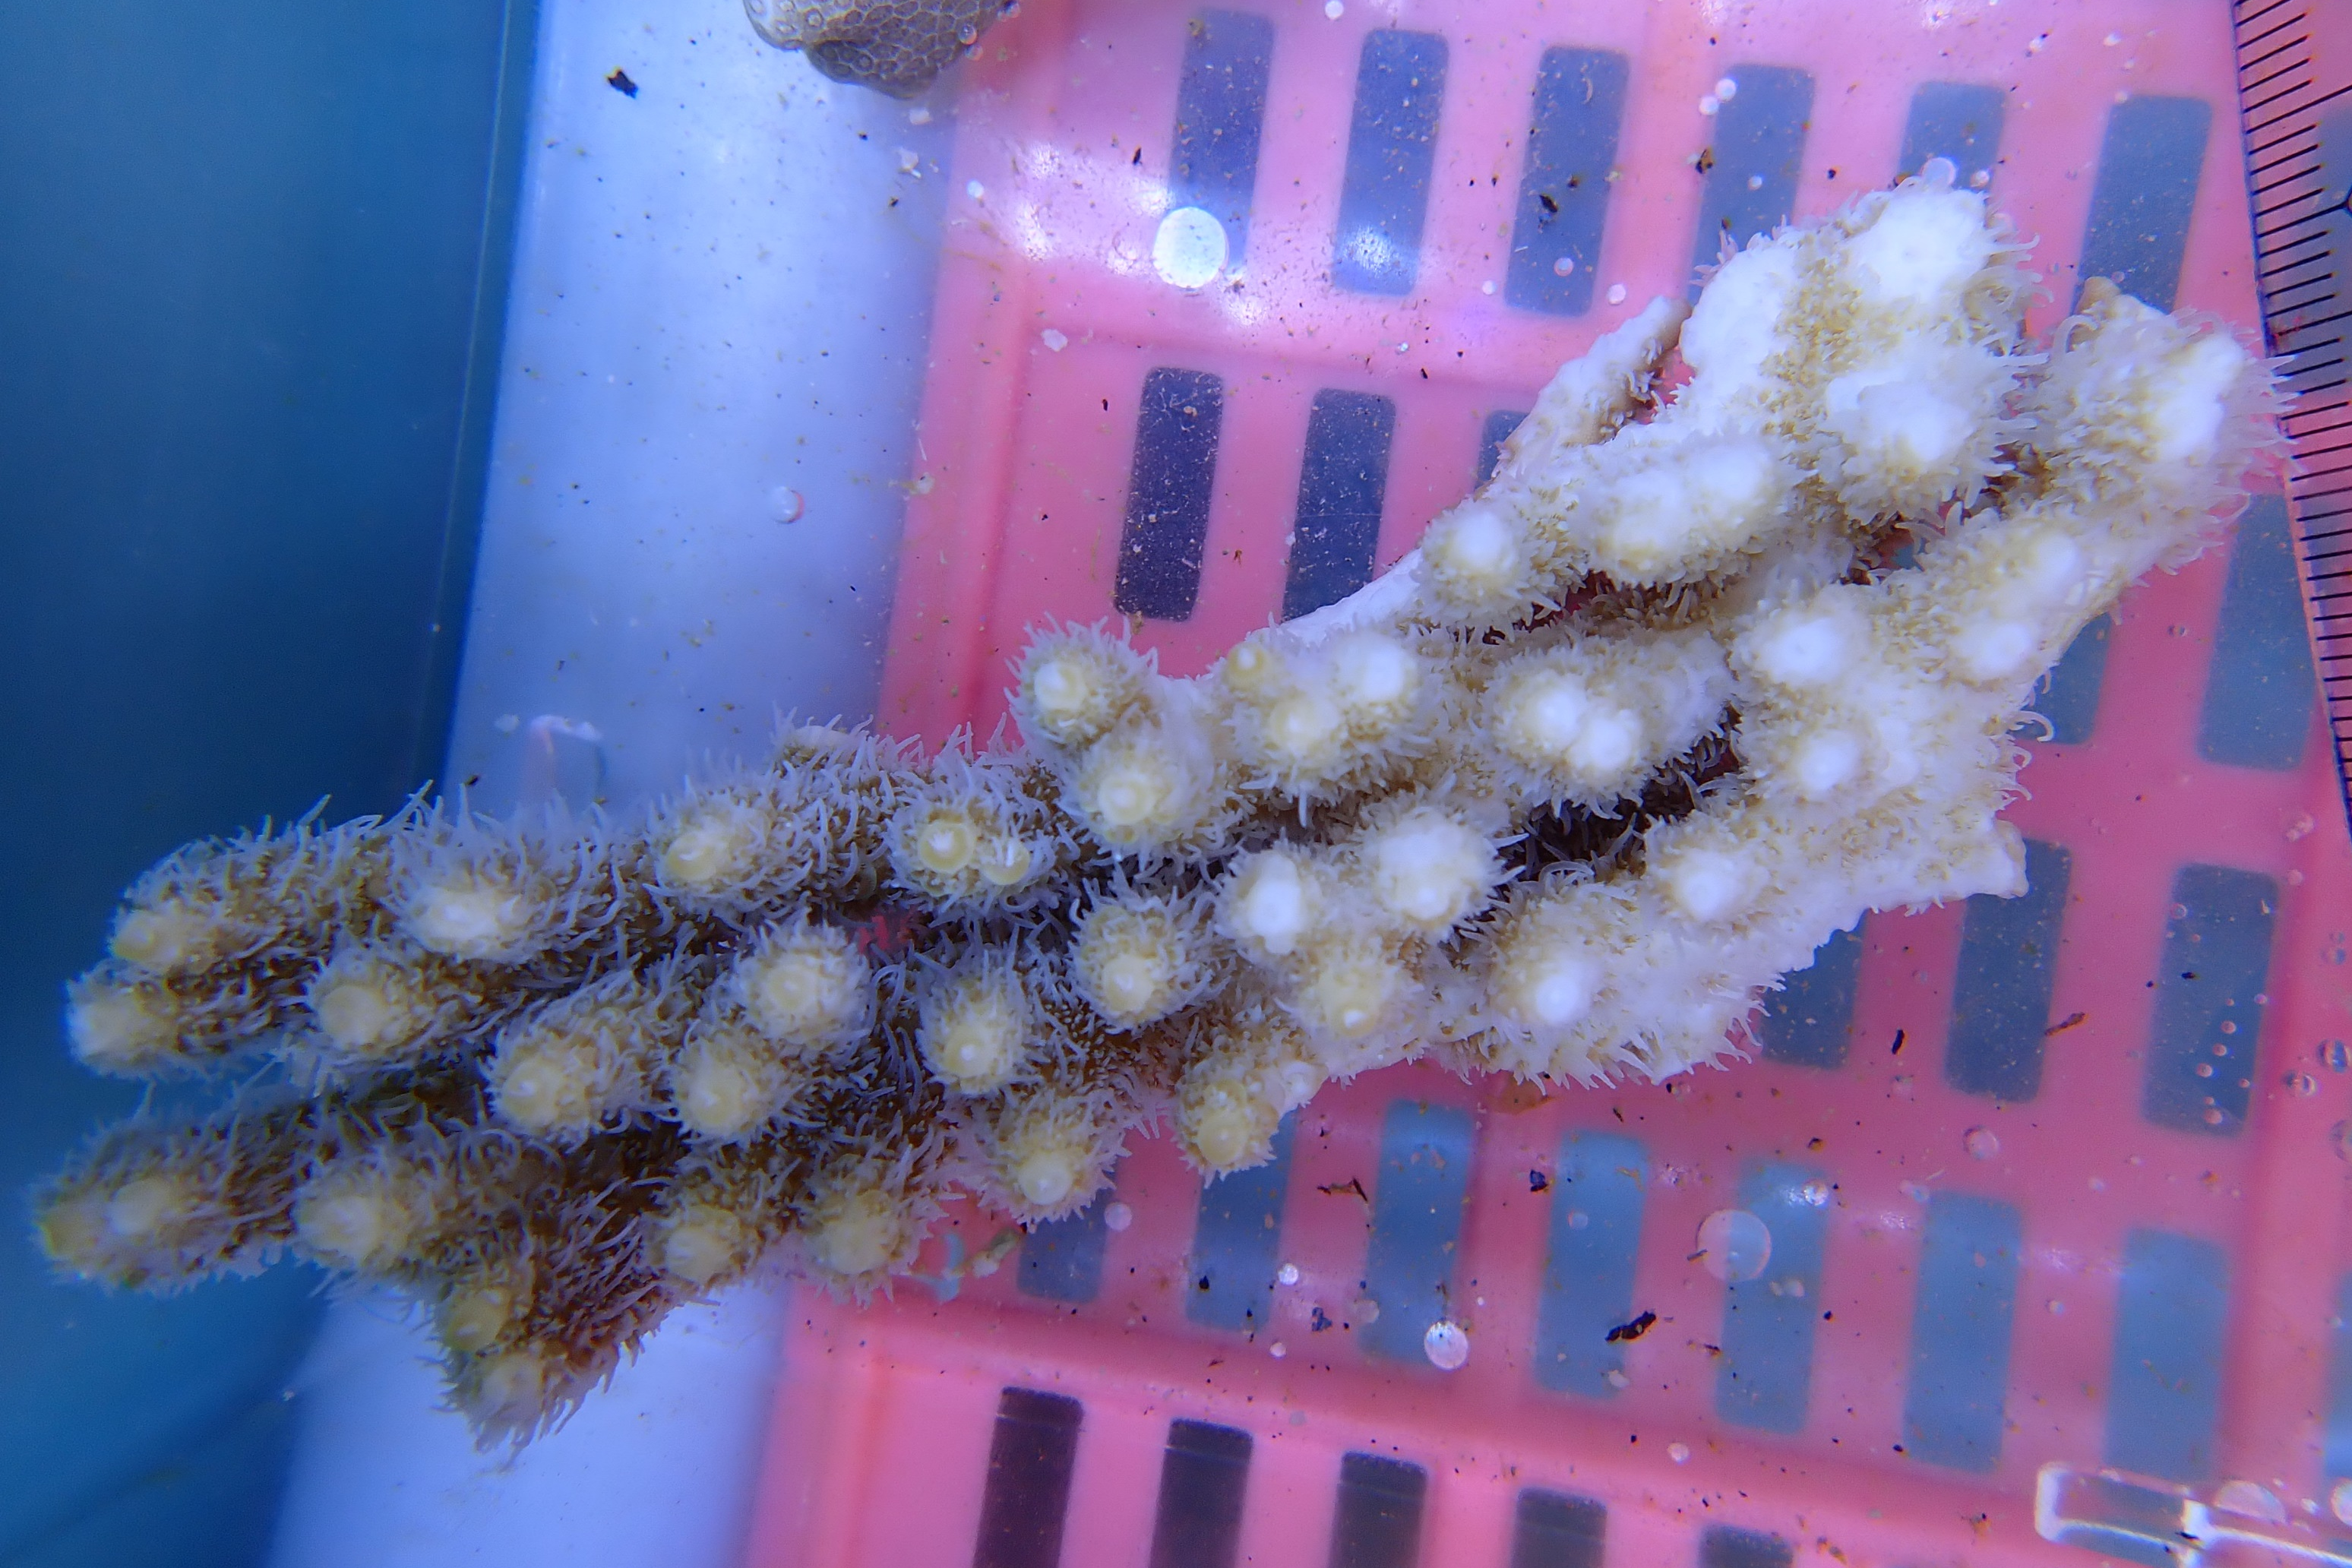
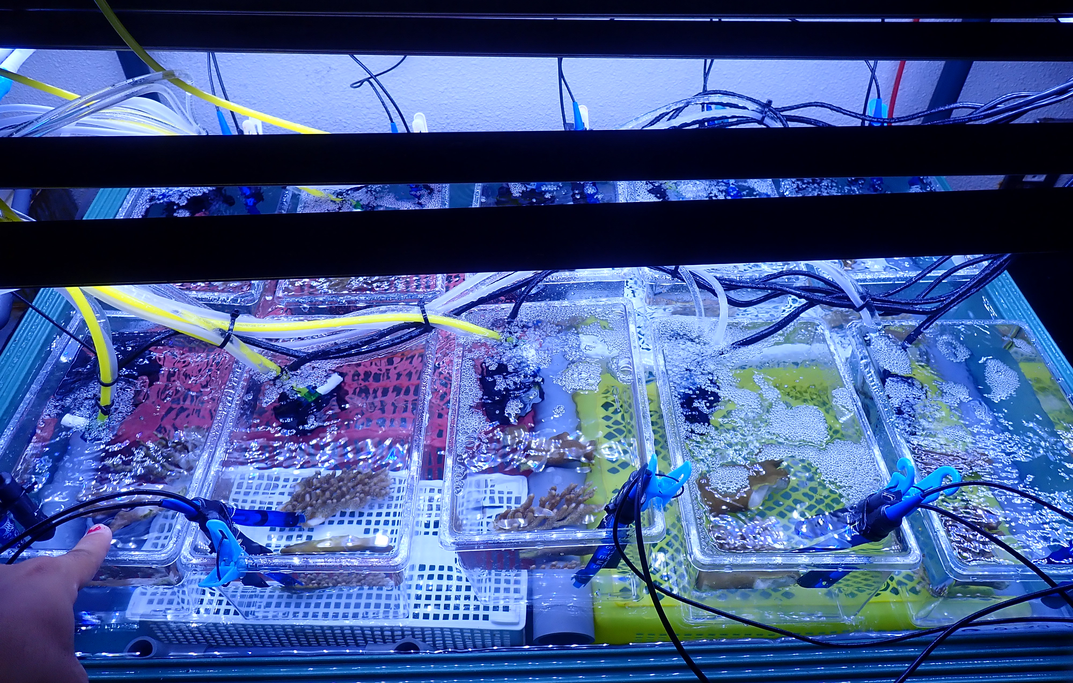
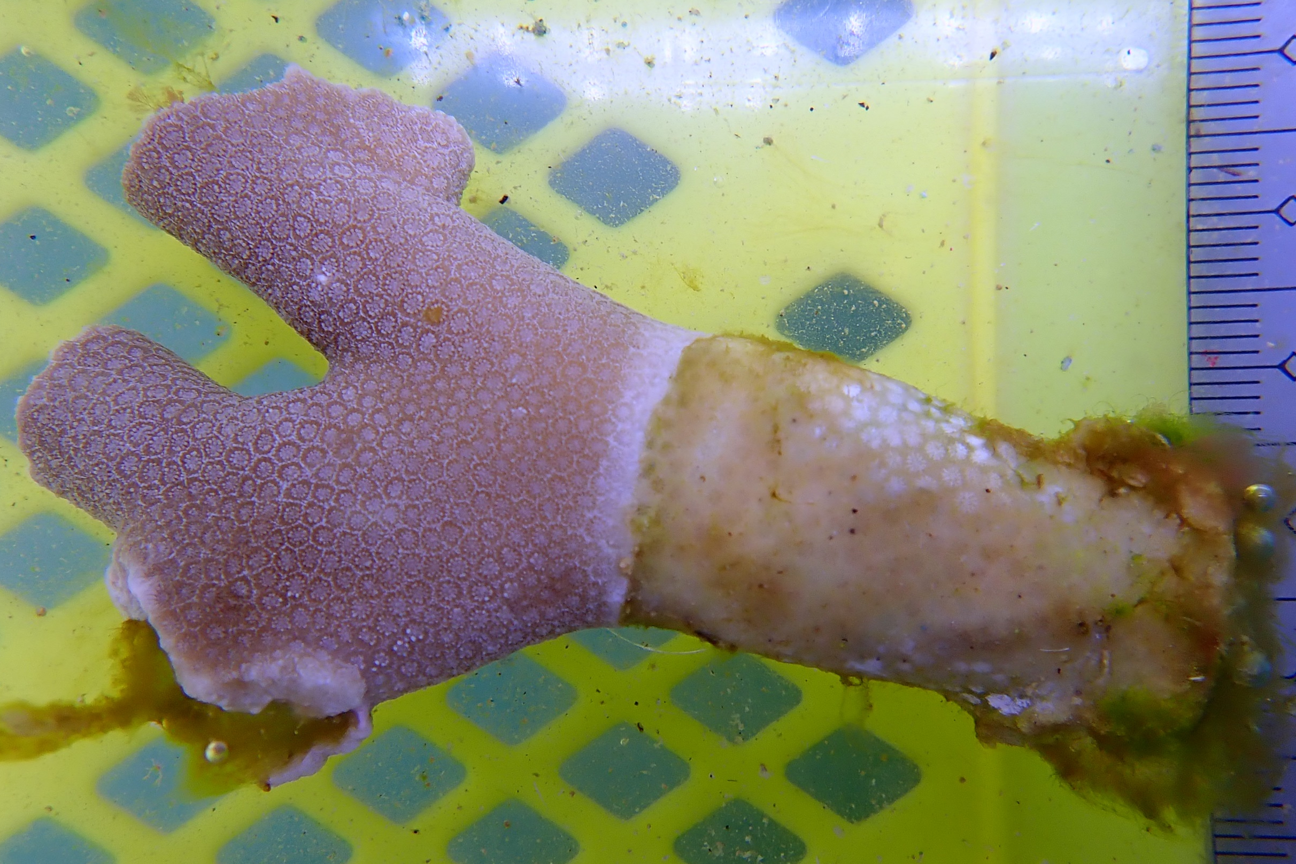
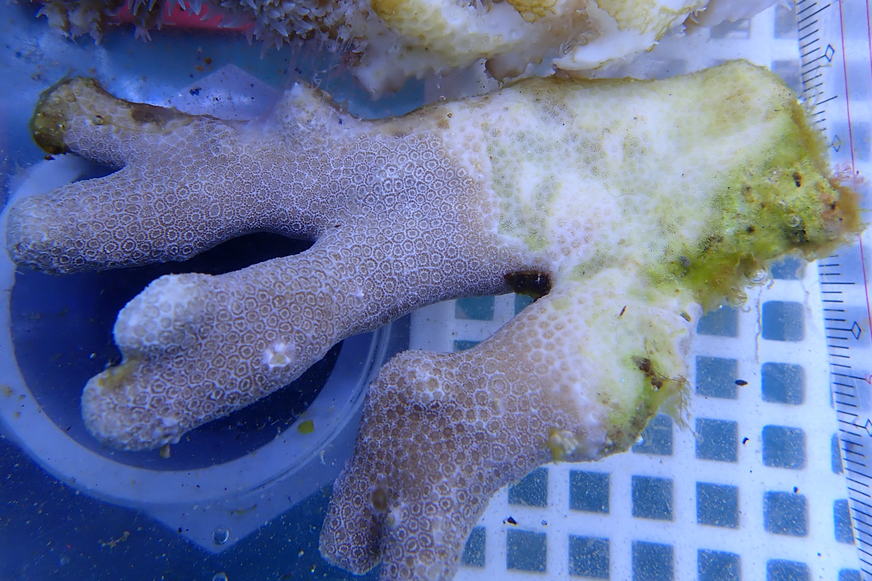
A
B
Shimoda Marine Research Center
Incubation Exp. (n = 10)
Shikine Island
Field Transplantation Exp. (n = 6)
Present-day
(8.18 pH, ~384 μatm pCO₂)
Future OA
(7.85 pH, ~912 μatm pCO₂)
Present-day
(8.26 pH, ~317 μatm pCO₂)
Future OA
(7.83 pH, ~1005 μatm pCO₂)
pH probe
temp. probe
water pump
CO₂ airstone
airstone
Acropora solitaryensis
Acropora solitaryensis
Porites heronensis
Porites heronensis
C
Tropical Biosphere Research Center Sesoko Station
Incubation Exp. (n = 5)
Acropora hyacinthus
Present-day
(8.15 pH, ~436 μatm pCO₂)
Future OA
(7.93 pH, ~797 μatm pCO₂)
Porites cylindrica

